Slide 1
Single cell RNA-seq data analysis handbook
Chengchen ZHAO, Zheting ZHANG, Yawen LYU, Wei SHI, Tianci KONG, Tiancheng Yu, Yuxiang YAO
2025.3.18

Slide 2
scRNA progress
Experiment Overview (Yawen)
Pre-process Pipeline (Zejie)
Downstream Analysis
Quality control (Wei & Tianci)
Cell clustering (Tianci & Zejie)
Cell type annotation (Yawen & Wei)
Marker gene detection (Tiancheng &Tianci)
Trajectory inference (Zheting & Zejie)
Similarity analysis (Wei & Zheting)
Cell interaction analysis (Yawen & Tiancheng)
Tricks
Extension & Limitation

Slide 3
Experiment Overview
04.BioinformaticsTraining_scRNAseqAnalysis.pptx
The first acquisition of single cell transcriptomics information
Throughput increased by 5’ end sequencing
The IVT method was introduced to control the errors introduced by PCR.
Introduced UMI。
The combination of microfluidic technology and cell barcode technology reduces costs and increases throughput.
Throughput increased
Achieve full-length pre-amplification
Throughput increased
Laser capture realizes single cell information acquisition.
STRT-seq UMI
10x genomics
Microwell-seq
Smart-seq
Smart-seq2
CEL-seq UMI
Quartz-seq
MARS-seq
CEL-seq2
Tang et.al.
STRT-seq
SCRB-seq
Drop-seq
SPLiT-seq
Cyto-seq
LCM-seq
CEL-seq
DP-seq
SC3-seq
inDrop
Div-seq
2009
2010
2011
2012
2013
2014
2015
2016
2017
2018
2019
2020
Credit :Yawen Lyu
3

Slide 4
Experiment Overview – 1 Introduction
What is bulk RNA-seq
RNA-seq is used in samples composed of cell mixtures, called bulk RNA-seq, and is often used to study transcriptome differences between control/diseased and wild-type/mutant. However, using bulk RNA-seq, we can only estimate the average expression level of each gene in the cell population, without considering the heterogeneity of gene expression in individual cells in the sample
What is single-cell RNA-seq
To solve the problem of heterogeneity, single-cell RNA-seq was first reported in 2009.Unlike bulk RNA-seq, scRNA-seq can evaluate the expression level distribution of each gene in different cell populations. It successfully solved the problem of cell-specific changes in the transcriptome. It can discover new or rare cell types, identify differential cell composition between control/diseased tissues, or understand cell differentiation during development.
Credit :Yawen Lyu

Slide 5
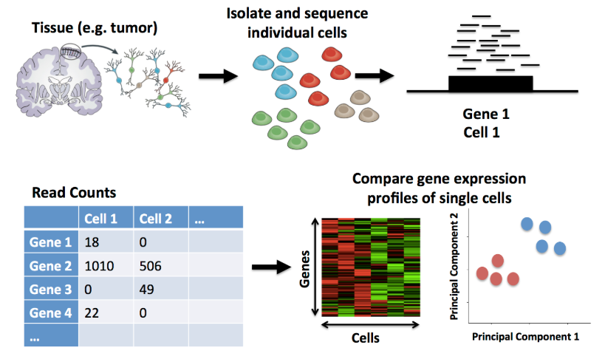
Experiment Overview – 2.1 Single-cell sequencing workflow
http://learn.gencore.bio.nyu.edu
Credit :Yawen Lyu

Slide 6
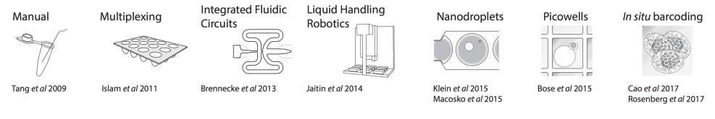
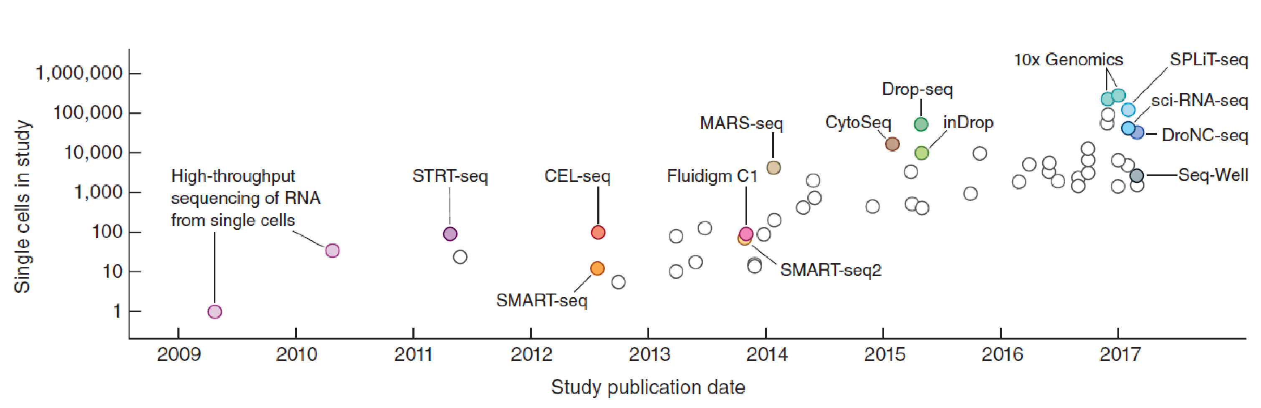
Experiment Overview – 2.2 Technical Development of scRNA-seq
Svensson et al. NATURE PROTOCOLS, 2018
Credit :Yawen Lyu

Slide 7
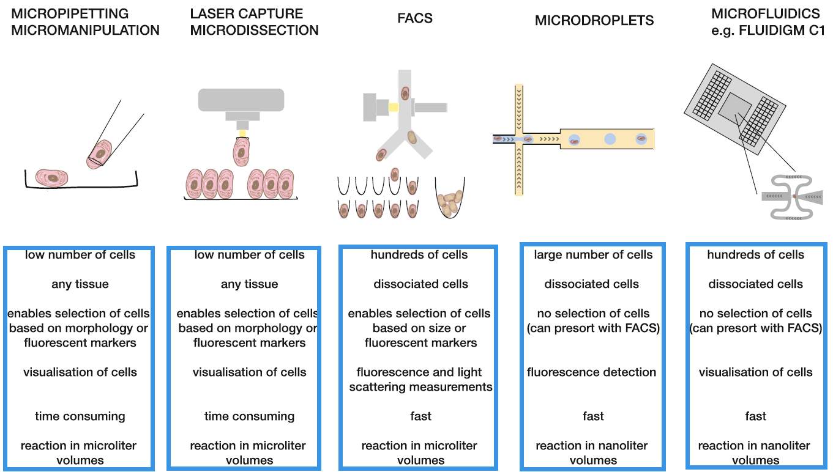
Experiment Overview – 1.3 Technical Development of scRNA-seq
Kolodziejczyk et al. Molecular Cell, 2015
Credit :Yawen Lyu

Slide 8
Experiment Overview – 2.3 Classification of single-cell transcriptome sequencing technologies
Full-length transcript sequencing technology (such as Smart-seq2, MATQ-seq, SUPeR-seq, etc.)
Advantages: can measure the full length of the transcript, detect gene expression more sensitively and accurately, and can perform various types of transcriptome sequencing data analysis
Disadvantages: low cell throughput and expensive
Only measure the 3′ or 5′ end of the transcript (3′ or 5′-end sequencing) technology (such as Drop-seq, Seq-Well, Chromium, DroNC-seq, STRT-seq, etc.)
Advantages: high cell throughput and low price
Disadvantages: only measure one end of the transcript, the sensitivity of detecting gene expression is low, and it is not suitable for analysis of alternative splicing, allele expression, etc.
Svensson et al. NATURE PROTOCOLS, 2018
Credit :Yawen Lyu

Slide 9
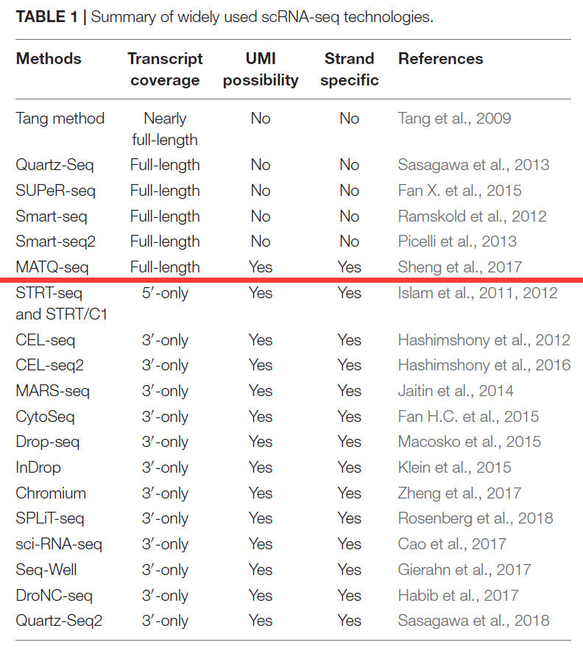
Experiment Overview – 2.4 Classification of single-cell transcriptome sequencing technologies
Chen et al. Frontiers in Genetics, 2019
Credit :Yawen Lyu

Slide 10
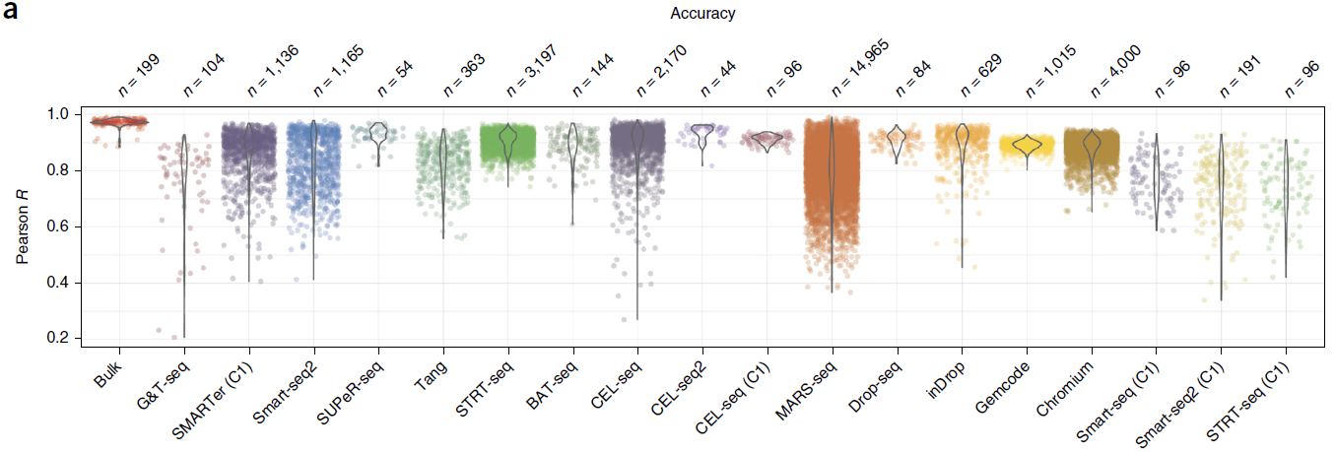
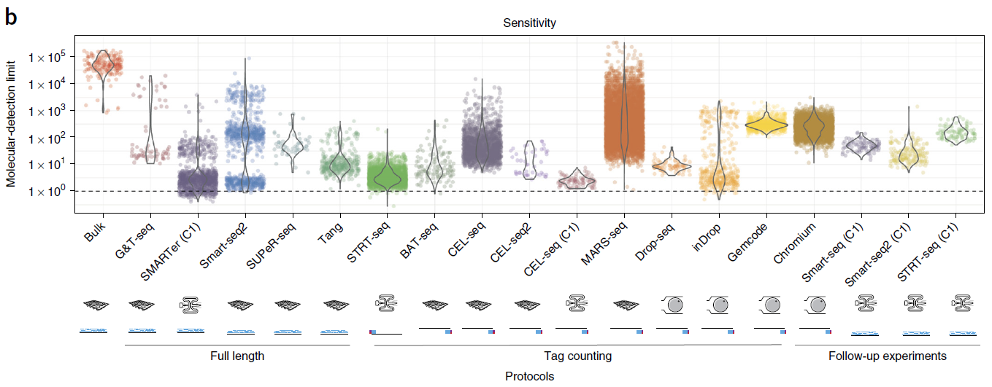
Experiment Overview -- 2.5 Comparison of different types of single-cell transcriptome sequencing technologies
Comparison of the performance of different types of single-cell transcriptome sequencing technologies in detecting gene expression. The results show that single-cell transcriptome sequencing technologies such as Smart-seq and MARS-seq have higher accuracy and sensitivity in detecting gene expression.
Credit :Yawen Lyu
Svensson, Nature Methods, 2017

Slide 11
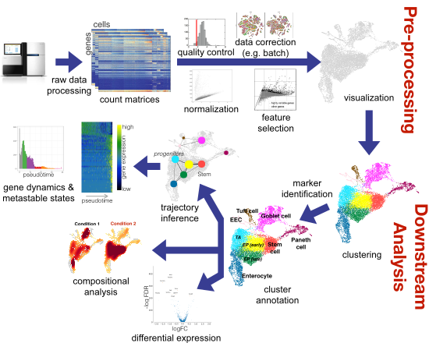
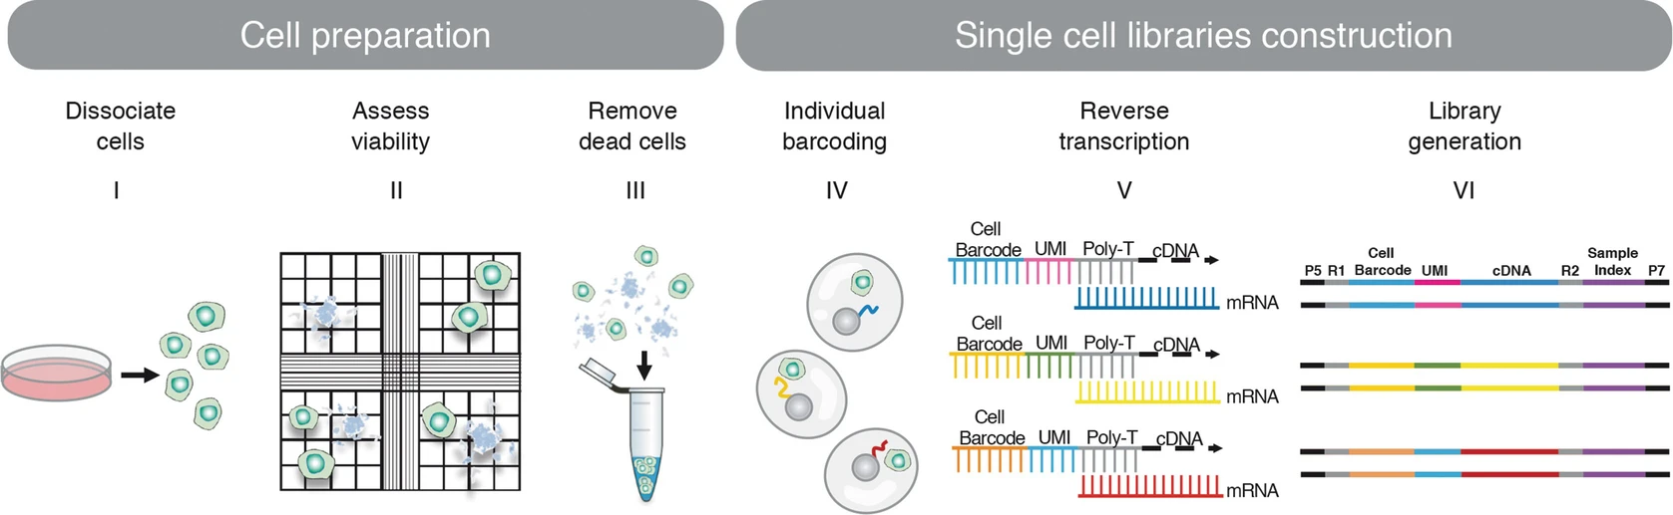
Experiment Overview – 3 Single-cell analysis workflow
Shaked et al. Methods Mol Biol, 2021
M.D. Luecken et al. Molecular Systems Biology , 2019
Credit :Yawen Lyu

Slide 12
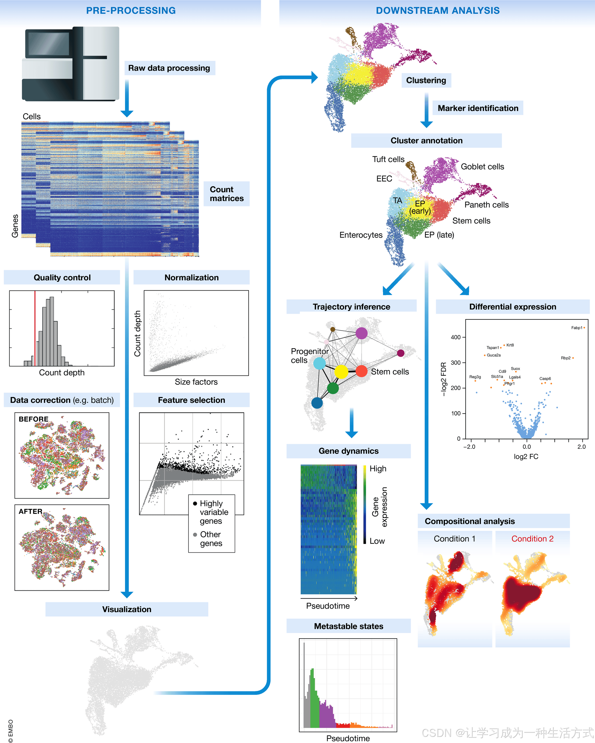
Experiment Overview – 2 Single-cell analysis workflow
https://zhuanlan.zhihu.com/p/345403616
Chen et al. Frontiers in Genetics, 2019
Sci-Hub | RNA Bioinformatics. Methods in Molecular Biology | 10.1007/978-1-0716-1307-8
Credit :Yawen Lyu

Slide 13
Pre-process pipeline
Droplet-based scRNA-seq (Drop-seq, 10x)
Dr.seq
CellRanger
Microwell-based scRNA-seq (Smart-seq)
RNA-seq pipeline
singleron-RD
Huada
Credit : Zejie Lin

Slide 14
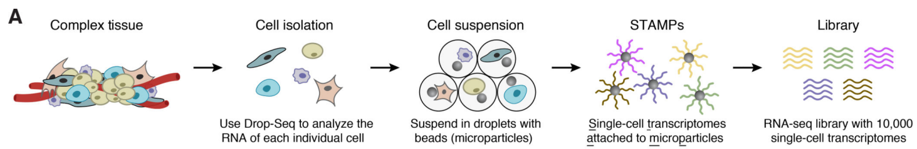
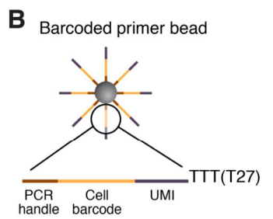
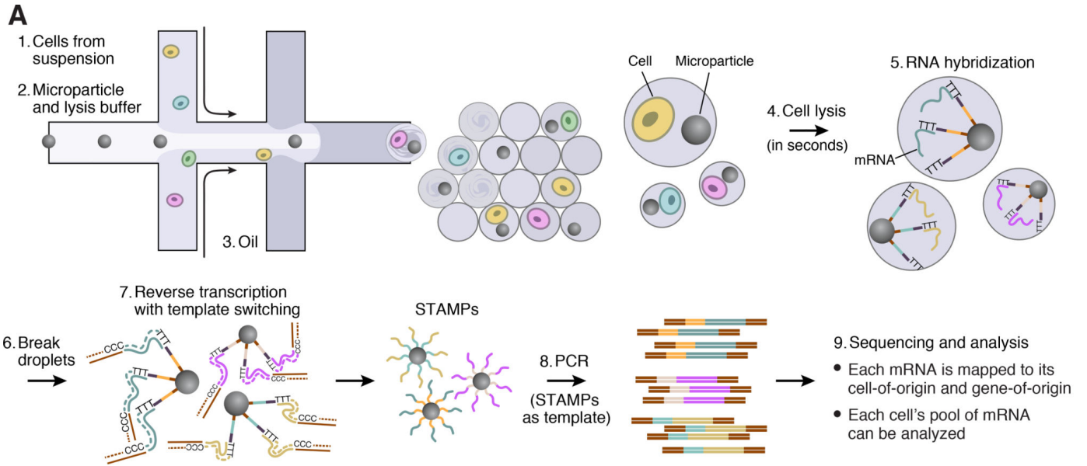
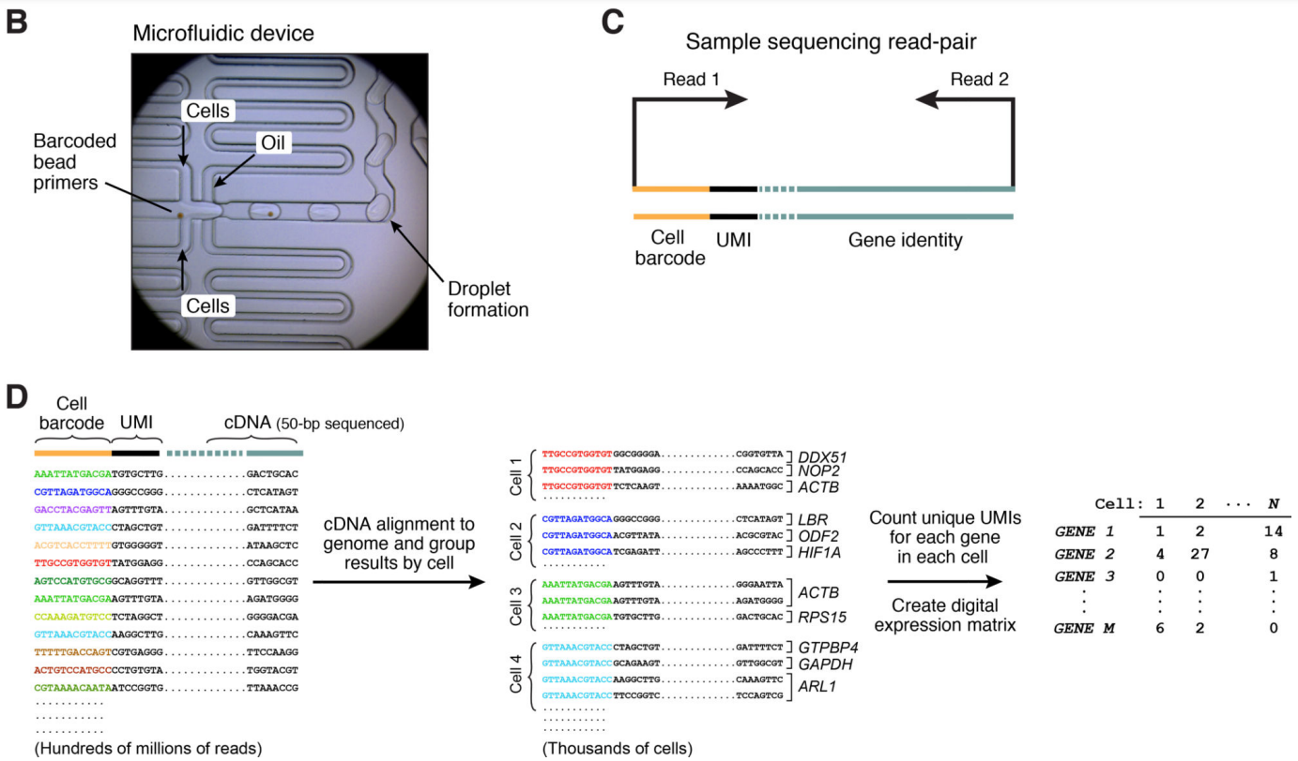
Pre-process pipeline: How 10X RNA-Seq Works
Wang et al., Genomics Proteomics Bioinformatics, 2021
Credit : Zejie Lin
Notes:
Drop-seq 包括以下步骤（图 1A）：（1）从组织中制备单细胞悬浮液；（2）将每个细胞与带有不同条形码的beads（珠子）共同封装在纳升级的液滴中；（3）将细胞分离到液滴中后在GEMs中被裂解进行裂解，释放mRNA（4）Gelbead磁珠捕获细胞伴随beads上的mRNA，形成STAMP（single-cell transcriptomes attached to microparticles，附着在微粒上的单细胞转录组）；（5）Gel bead会破碎，释放大量随机引物，与酶反应生成cDNA；在一次反应中逆转录、扩增和测序数千个STAMP；（6）使用 STAMP 条形码推断每个转录本的来源细胞。
首先在凝胶微珠上种上特定的DNA片段，DNA片段由三部分组成：Barcode、UMI、PolyT组成。
reads 1:主要用于定量，reads 2:与基因组比对，Barcode:标记细胞，UMI：标记基因

Slide 15
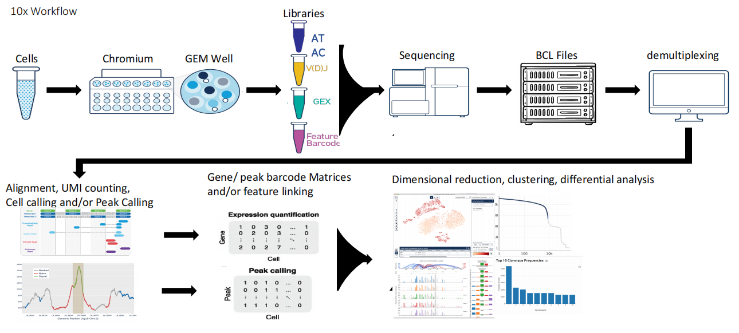
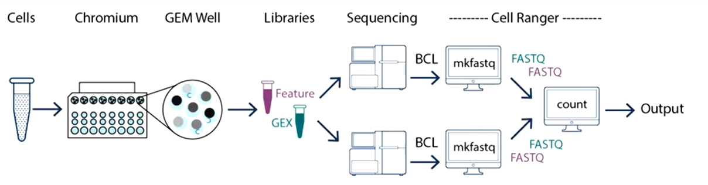
Pre-process pipeline: 10x workflow
Cell Ranger, 10x Genomics (https://www.10xgenomics.com)
Credit : Zejie Lin

Slide 16
Pre-process pipeline: CellRanger Introduction
A set of analysis pipelines that process Chromium Next GEM single cell data to align reads, generate feature-barcode matrices, perform clustering and other secondary analysis.
Capable of analyzing V(D)J, Gene Expression, and Feature Barcode data
Contains various pipelines for:
Demultiplexing (mkfastq)
Single sample V(D)J assembly and annotation (vdj)
Single sample V(D)J with gene expression and/or feature barcoding analysis (multi)
Single sample gene expression and/or feature barcode analysis (count)
Combining data from multiple samples into an experiment-wide analysis (aggr)
Reanalyzing GEX and feature barcode data with custom parameters (reanalyze)
Easy to download and run on Linux
Credit : Zejie Lin

Slide 17
Pre-process pipeline: CellRanger
Pipeline by library type
Documentation by library type | Cell Ranger pipeline
3' Gene Expression | count
3' Gene Expression + Antibody/CRISPR Guide Capture | count
Antibody Capture only | count
3' Gene Expression + Cell Multiplexing (+ Antibody/CRISPR Guide Capture) | multi
Fixed RNA Profiling Gene Expression (+ Antibody/CRISPR Guide Capture) | multi
5' V(D)J only | vdj
5' Gene Expression only | count
5' Antibody Capture (+ Gene Expression) | count
5' CRISPR (FB) + Gene Expression | count
5' Gene Expression + V(D)J (+ FB) | multi
5' Gene Expression + V(D)J + Antigen Capture (BEAM) (+ Antibody Capture) | multi
Cell Ranger, 10x Genomics (https://www.10xgenomics.com)
Credit : Zejie Lin

Slide 18
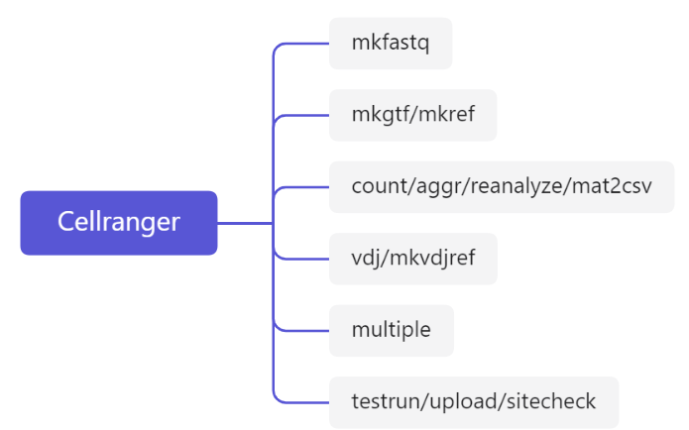
Pre-process pipeline: CellRanger
a wrapper around Illumina’s bcl2fastq2 program for demultiplexing Illumina base call files (BCL) and outputs FASTQ files
cellranger provides human and mouse reference genomes, can construct other species’ reference genomes
count: quantify cell and gene, generate gene expression matrix
aggr: integrate multiple data sets
reanalyze: dimension reduction, clustering, differential analysis
mat2csv: bulid matrix
Immune Profiling Kit
analyze Cell Multiplexing data
Auxiliary functions. Software test, upload data
Credit : Zejie Lin

Slide 19
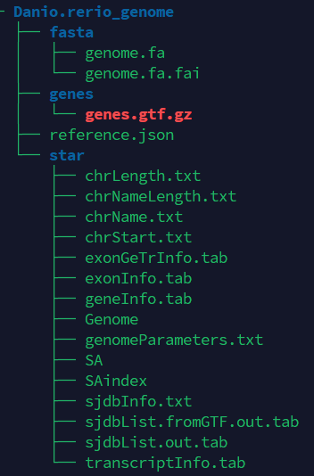
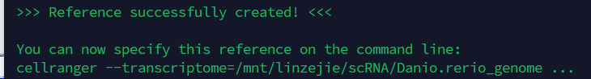
Pre-process pipeline: CellRanger mkref
1. Download gtf and fasta files
wget http://ftp.ensembl.org/pub/release-105/gtf/danio_rerio/Danio_rerio.GRCz11.105.gtf.gz
wget http://ftp.ensembl.org/pub/release-105/fasta/danio_rerio/dna/Danio_rerio.GRCz11.dna.primary_assembly.fa.gz
gunzip Danio_rerio.GRCz11.105.gtf.gz
gunzip Danio_rerio.GRCz11.dna.primary_assembly.fa.gz
2. Filter the gtf
Remove entries for non-polyA transcripts that overlap with protein-coding gene models
cellranger mkgtf \
Danio_rerio.GRCz11.105.gtf \
Danio_rerio.GRCz11.105.filtered.gtf \
--attribute=gene_biotype:protein_coding
3. Run cellranger mkref
cellranger mkref \
--genome=Danio.rerio_genome \
--fasta=Danio_rerio.GRCz11.dna.primary_assembly.fa \
--genes=Danio_rerio.GRCz11.105.filtered.gtf
Credit : Zejie Lin

Slide 20
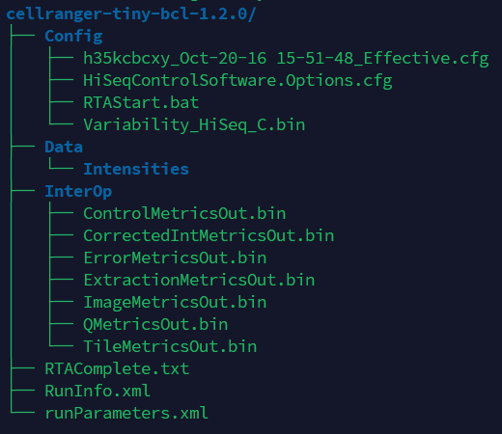
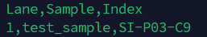
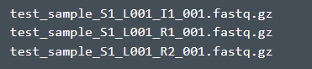
Pre-process pipeline: CellRanger mkfastq
1. Download gtf and fasta files
wget https://cf.10xgenomics.com/supp/cell-exp/cellranger-tiny-bcl-1.2.0.tar.gz
wget https://cf.10xgenomics.com/supp/cell-exp/cellranger-tiny-bcl-simple-1.2.0.csv
tar -zxvf cellranger-tiny-bcl-1.2.0.tar.gz
cellranger-tiny-bcl-1.2.0/
cellranger-tiny-bcl-simple-1.2.0.csv
2. Run cellranger mkfastq
cellranger mkfastq --id=tutorial_walk_through \
--run=/mnt/home/user.name/yard/run_cellranger_mkfastq/cellranger-tiny-bcl-1.2.0 \
--csv=/mnt/home/user.name/yard/run_cellranger_mkfastq/cellranger-tiny-bcl-simple-1.2.0.csv
If you are already starting with FASTQ files, you can skip this step and proceed directly to run cellranger count.
Credit : Zejie Lin

Slide 21
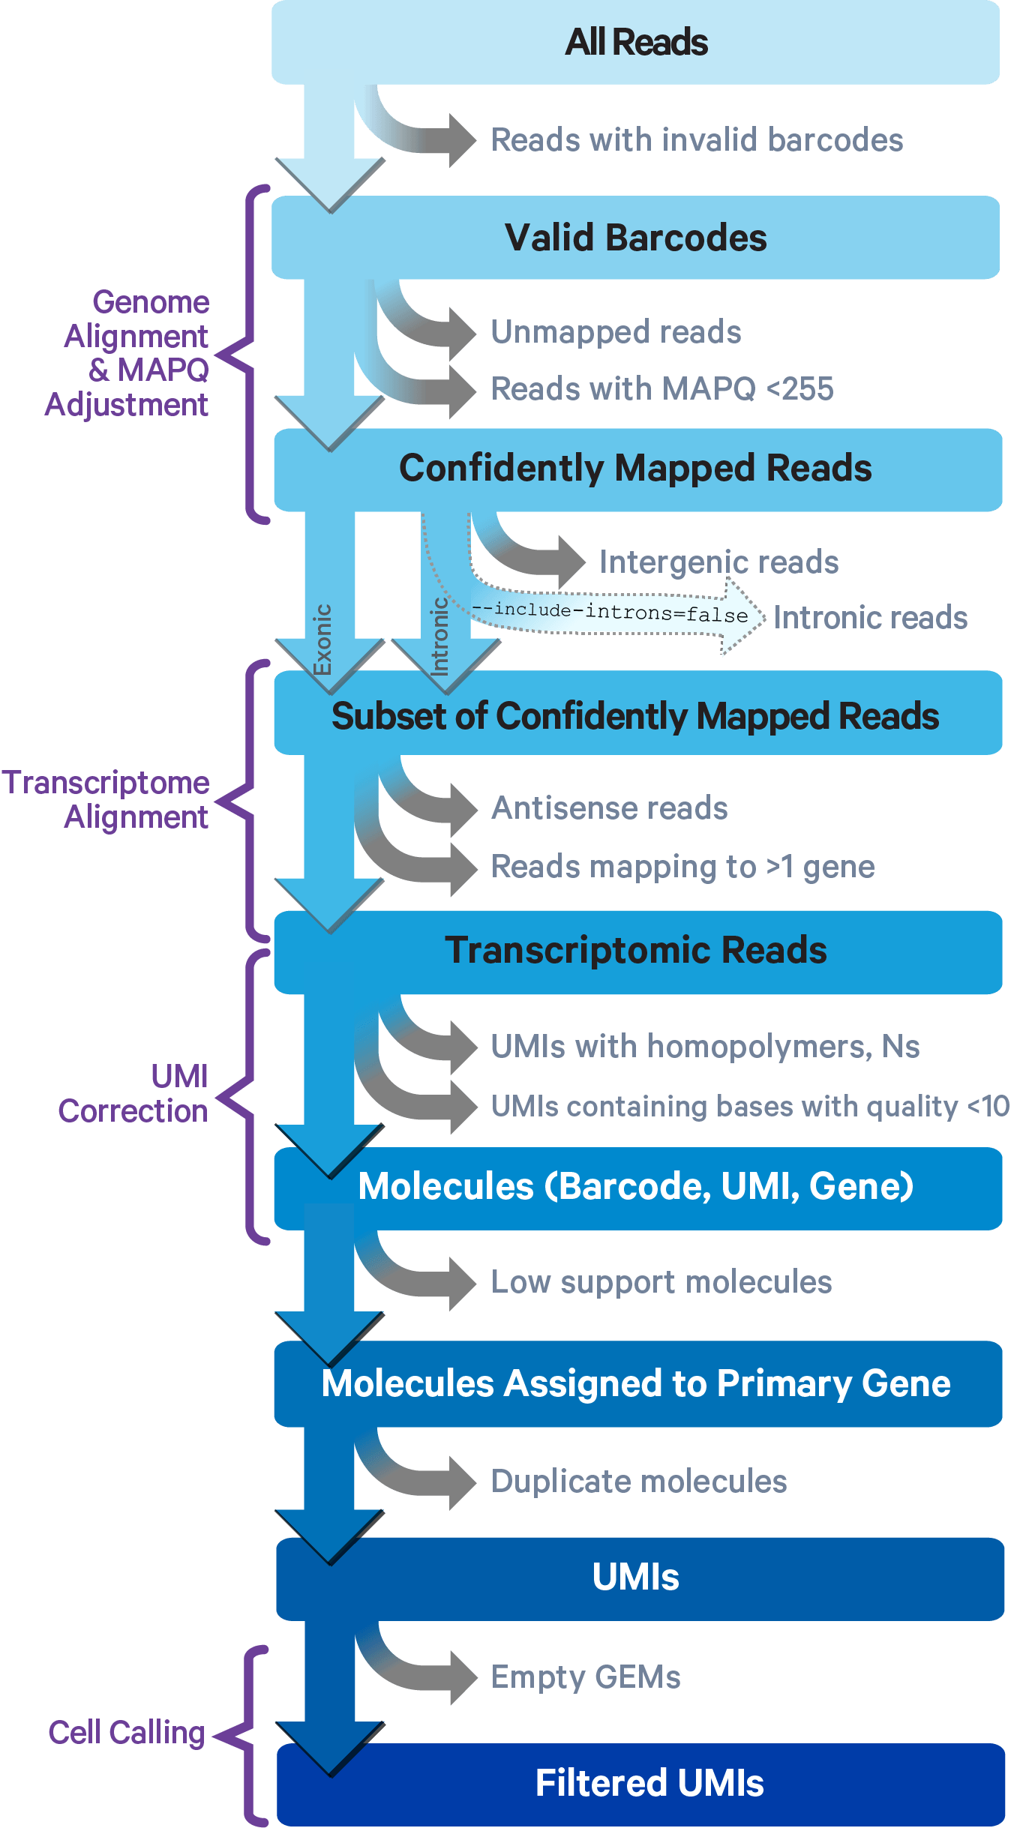
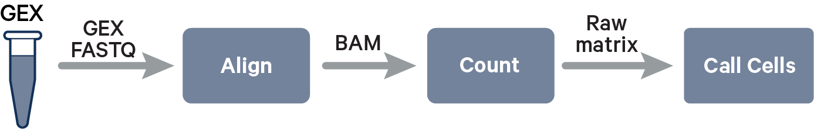
Pre-process pipeline: CellRanger count
Barcode Correction:
Cell Ranger performs barcode correction by comparing observed barcodes to a whitelist of known barcodes for the assay chemistry. For example,
Single Cell 3' v2 and V(D)J assays have ~737,000 barcodes in the whitelist,
Single Cell 3' v3 and v3.1 assays have ~3 million.
Correction Algorithm:
1. Count Frequencies: Cell Ranger counts each whitelist barcode's frequency in the dataset.
2. Identify Similar Barcodes: For any observed barcode not on the whitelist but within one Hamming distance (one base difference) of a whitelist barcode:
Calculate the posterior probability that the barcode is a sequencing error of a whitelist barcode, using base quality scores.
Replace it with the whitelist barcode if the probability is above 0.975.
Credit : Zejie Lin
Cell Ranger, 10x Genomics (https://www.10xgenomics.com)
Notes:
Barcode correction:
为了确保barcode序列的准确性，会将捕获到的barcode与白名单进行比较
• Single cell 3’v2: 737000
• Single cell 3’v3: ~3 million
如果数据中的barcode不存在且与白名单中的序列有1个单位的汉明距离
• 计算后验概率
• 概率大于0.975，将该barcode替换为白名单中对应的barcode

Slide 22
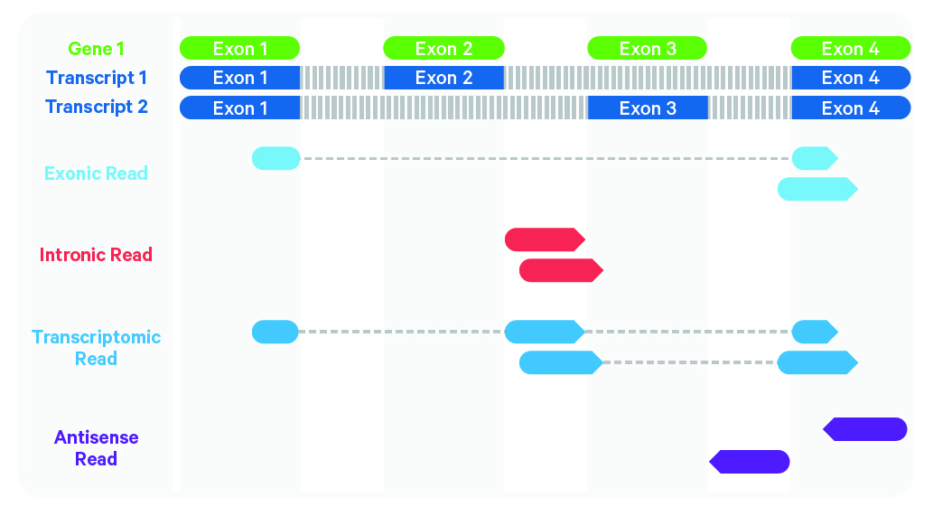
Pre-process pipeline: CellRanger count
Read trimming
Genome alignment
MAPQ adjustment
Transcriptome alignment
Apply to 3' gene expression assays
Trim the non-template TSO sequence from the 5' end and the poly-A tail from the 3' end of cDNA improves the accuracy and sensitivity of alignment.
Use STAR, splicing-aware alignment of reads to the genome.
Use transcript annotation GTF to bucket the reads into exonic, intronic, and intergenic.
Exonic: >50% intersects an exon
Intronic: non-exonic and intersects an intron, and
Intergenic otherwise.
For reads that align to a single exonic locus but also align to 1 or more non-exonic loci, the exonic locus is prioritized and the read is considered to be confidently mapped to the exonic locus with MAPQ 255.
Apply to 3' gene expression assays
Trim the non-template TSO sequence from the 5' end and the poly-A tail from the 3' end of cDNA improves the accuracy and sensitivity of alignment.
Credit : Zejie Lin
Cell Ranger, 10x Genomics (https://www.10xgenomics.com)
Notes:
适用于3′基因表达测定 将cDNA 5′端非模板TSO序列和3′端poly-A尾剪去，提高比对的准确性和灵敏度。
Genome alignment:
将reads按照如下规则划分为exonic、intronic和intergenic
• Exonic：与外显子区域有50%以上重合率的reads
• Intronic：与内含子区域有重合的非外显子reads
• Intergenic：其余reads

Slide 23
Pre-process pipeline: CellRanger count
1. UMI correction
Reads confidently mapped to the transcriptome are grouped by barcode, UMI, and gene annotation.
If two groups of reads share the same barcode and gene but have UMIs differing by only one base (one Hamming distance), a substitution error may have occurred. In this case, the UMI of the group with fewer supporting reads is corrected to the UMI of the group with higher support.
2. Grouping by Barcode, UMI, and Gene Annotation again
If multiple groups of reads have the same barcode and UMI but different gene annotations, the gene annotation with the most supporting reads is kept, while the other groups are discarded.
If there’s a tie in read support between gene annotations, all groups are discarded, as the gene cannot be confidently assigned.
3. UMI counting
After these two filtering steps, each unique barcode, UMI, and gene combination is counted as a UMI in the unfiltered feature-barcode matrix.
The number of reads supporting each counted UMI is also recorded in the molecule info file.
In this way, Cell Ranger is able to perform UMI counts more accurately and generate high-quality gene expression data.
Raw feature-barcode matrix
Credit : Zejie Lin
Cell Ranger, 10x Genomics (https://www.10xgenomics.com)
Notes:
UMI correction:
正式计数前，会对UMI进行矫正
• 相同barcode和gene
• 相同barcode和UMI
UMI存在一个碱基的差异，reads数较少的一组将被替换
reads数较少的一组直接丢弃

Slide 24
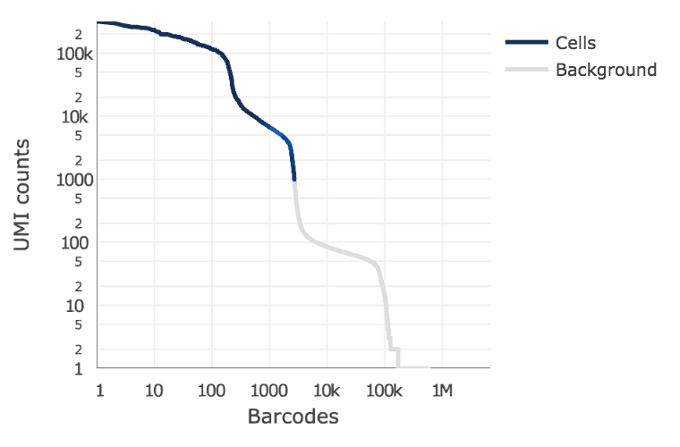
Pre-process pipeline: CellRanger count
Cell Calling
The algorithm has two key steps:
It uses a cutoff based on total UMI counts for each barcode to identify cells. This step identifies the initial number of high RNA content cells (initial cells).
Then the algorithm uses the RNA profile of each remaining barcode to determine if it is an "empty" or a cell-containing partition. This second step captures low RNA content cells whose total UMI counts may be similar to empty GEMs.
filtered feature-barcode matrix
Credit : Zejie Lin
Cell Ranger, 10x Genomics (https://www.10xgenomics.com)
Notes:
细胞识别算法主要包括两个步骤
1. 依据总UMI计数值对barcode进行排序，找出高RNA含量的初始细胞
2. 建立背景模型，使用Good-Turning smoothing算法找出低RNA含量的细胞

Slide 25
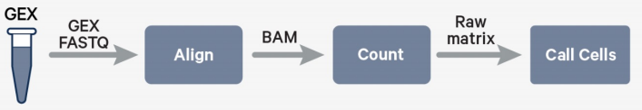
Pre-process pipeline: CellRanger count
Inut File
[Sample Name]_S1_L00[Lane Number]_[Read Type]_001.fastq.gz
Read Type:
T1:Sample index read(optional)
T2:Sample index read(optional)
R1:Read1
R2:Read2
eg: Test_S1_L001_R1_001.fastq.gz
Test_S1_L001_R2_001.fastq.gz
cellranger count--id #Output directory name
--transcriptome #Genome index file path
--fastqs #FASTQ file path
--sample #sample to run
#optional parameters
--include-introns #Whether to include introns when quantifying (version 7.0 defaults to True)
--lanes #lane num --expect-cells #Expected number of recovered cells in cell calling
--no-bam #no Bam output --force-cells #Force pipeline to use this number of cells in cell calling
--nosecondary #No downstream analysis (quantitative only)
--localcores #maximum number of cores --localmem #maximum memory (GB)
Credit : Zejie Lin

Slide 26
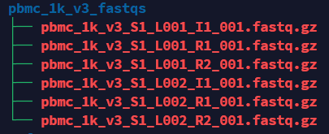
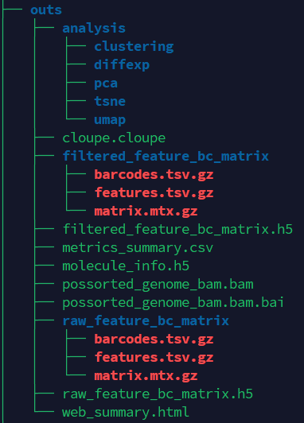
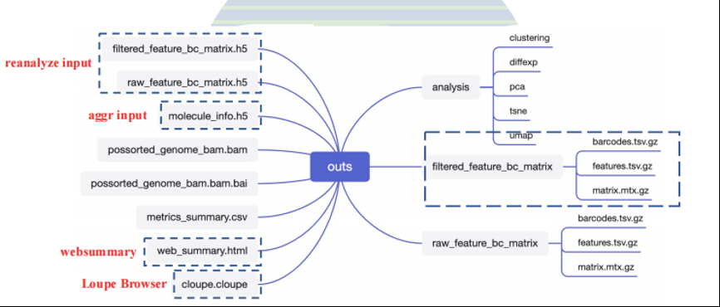
Pre-process pipeline: CellRanger count
Run cellranger count
input
cellranger count --id=run_count_1kpbmcs \
--fastqs=/mnt/linzejie/scRNA/count/pbmc_1k_v3_fastqs \
--sample=pbmc_1k_v3 \
--transcriptome=/mnt/linzejie/scRNA/count/refdata-gex-GRCh38-2020-A
cellranger count ouput
Credit : Zejie Lin

Slide 27
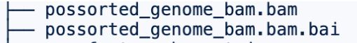
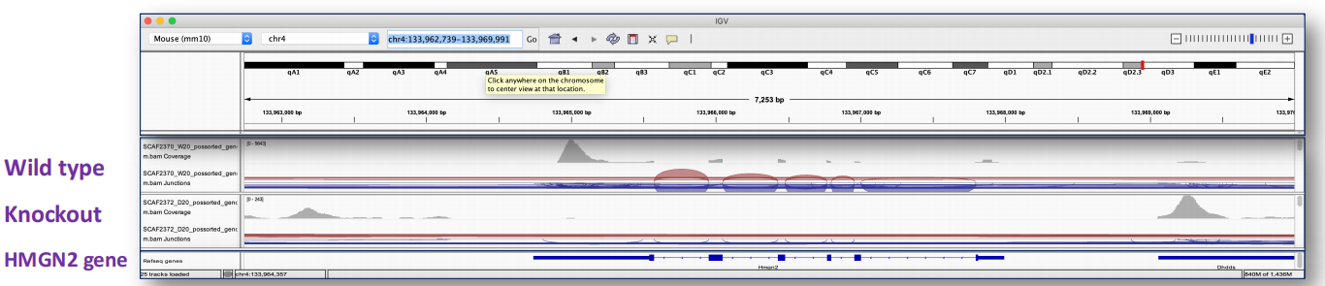
Pre-process pipeline: CellRanger count result
BAM and Bai file
An indexed BAM file containing position-sorted reads aligned to the genome and transcriptome, as well as unaligned reads
Can be used to generate Fastq
(bamtofastq available on cellranger suite)
Can be imported to IGV (Integrative Genomics Viewer) e.g. for checking coverage of any gene of interest like knock out genes
Credit : Zejie Lin

Slide 28
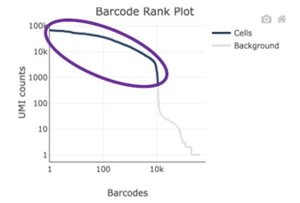
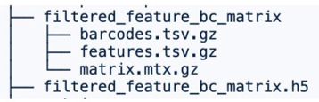
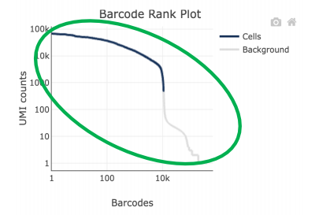
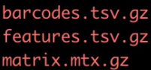
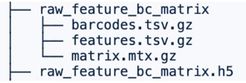
Pre-process pipeline: CellRanger count result
filtered_feature_bc_matrix
Contains only detected cell-associated barcodes.
Each element of the matrix is the number of UMIs associated with a feature (row) and a barcode (column).
raw_feature_bc_matrix
Contains every barcode from the fixed list of known-good barcode sequences that has at least one read. This includes background and cell-associated barcodes.
Each element of the matrix is the number of UMIs associated with a feature (row) and a barcode (column)
Two formats of feature barcode matrix
Market Exchange Format (MEX)
Hierarchical Data Format (HDF5)
H5 is a binary format that can compress and access data much more efficiently than text formats such as MEX, which is especially useful when dealing with large datasets. H5 files are supported in both R and Python.
molecule_info.h5
Contains per-molecule information for all molecules that contain a valid barcode, valid UMI, and were assigned with high confidence to a gene or Feature Barcode. This file is a required input to run cellranger aggr.
Credit : Zejie Lin

Slide 29
Pre-process pipeline: CellRanger count secondary analysis
Analysis folder
• Graph-based clusters
• K-means clustering 2-10
• PCA, t-SNE, and UMAP dimensionality reduction
• Differential gene expression analysis between clusters
CellRanger uses a streamlined sSeq approach, based on negative binomial testing, to identify differential genes across clusters. When UMI counts are high, CellRanger will automatically switch to edgeR for beta testing to improve speed.
1
To identify differential genes between a specific cluster and all other clusters within the same sample, the criteria are set as UMI > 1, q-value < 0.1, and Log2 fold change (Log2FC) > 0.
2
Differential gene expression
3
In the result files, for displaying marker genes and in enrichment analysis, differential genes are selected based on the criteria: UMI > 1, q-value < 0.05, and Log2FC > 0.
Credit : Zejie Lin

Slide 30
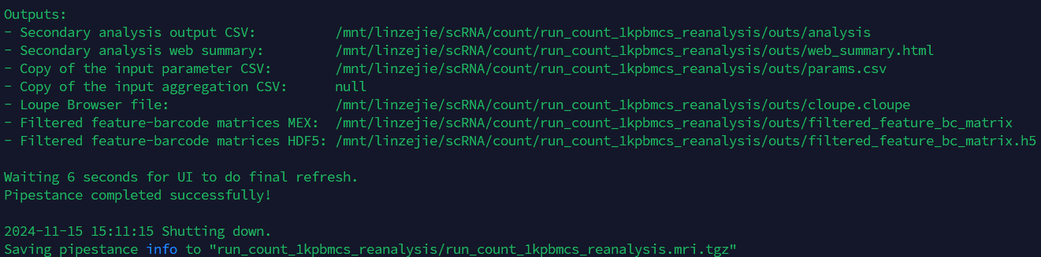
Pre-process pipeline: CellRanger reanalyze
Customized Secondary Analysis with cellranger reanalyze
The cellranger reanalyze command reruns secondary analysis performed on the feature-barcode matrix (dimensionality reduction, clustering, and visualization) using different parameter settings.
cellranger reanalyze --id=run_count_1kpbmcs_reanalysis \ # output id
--matrix=./run_count_1kpbmcs/outs/filtered_feature_bc_matrix.h5 \ # feature_bc_matrix.h5
--params=reanalysis.csv
--params csv file example
num_principal_comps,50 # More principal components and clusters
max_clusters,30
num_pca_bcs,50000 # Less memory usage
num_pca_genes,3000
output
Credit : Zejie Lin

Slide 31
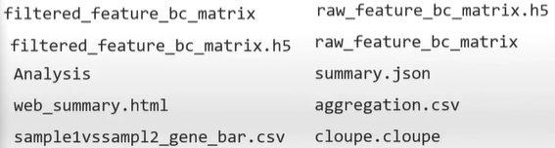
Pre-process pipeline: CellRanger aggregate
Aggregate multiple GEM wells from a single experiment that were analyzed by cellranger count and produces a single feature-barcode matrix containing all the data
There are two modes:
None: Do not normalize at all. maximize sensitivity and plan to handle depth normalization in a downstream step
Mapped (default): For each library type, subsample reads from higher-depth GEM wells until they all have, on average, an equal number of reads per cell that are confidently mapped to the transcriptome (Gene Expression) or assigned to known features (Feature Barcode Technology). This approach avoids artifacts that may be introduced due to differences in sequencing depth.
run aggregate
cellranger aggr --id=AGG123 \ # output directory name
--csv=AGG123_libraries.csv # Sample descriptive file
Sample descriptive file
sample_id,molecule_h5
Sample1,/opt/runs/Run1/outs/per_sample_outs/Sample1/count/sample_molecule_info.h5
Sample2,/opt/runs/Run1/outs/per_sample_outs/Sample2/count/sample_molecule_info.h5
Output
Credit : Zejie Lin
Notes:
aggr 主要用于合并不同文库的分析结果,aggr一般不用于合并单个文库的不同测序结果
测序深度归一化

Slide 32
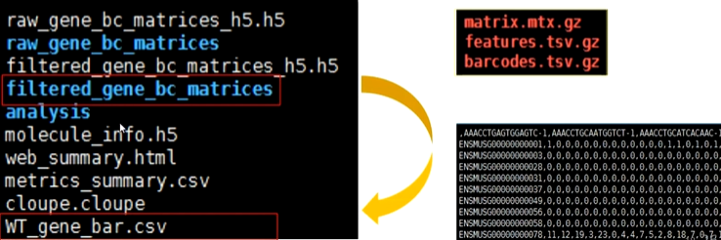
Pre-process pipeline: CellRanger mat2csv
cellranger mat2csv filtered_gene_bc_matrices WT_gene_bar.csv
Credit : Zejie Lin
Notes:
aggr 主要用于合并不同文库的分析结果,aggr一般不用于合并单个文库的不同测序结果
测序深度归一化

Slide 33
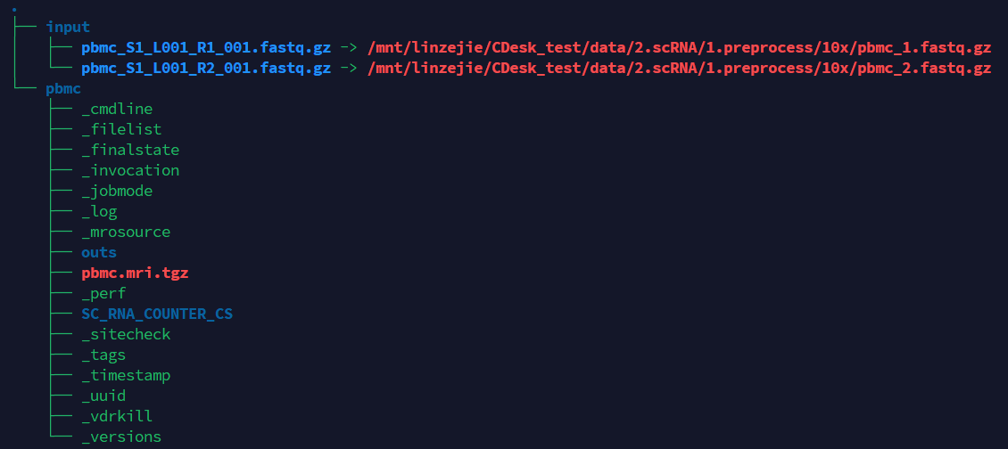
Pre-process
- Cellranger Preprocess
Tools：CDesk
Input command line:
CDesk scRNA preprocess cellranger \
-i /mnt/linzejie/CDesk_test/data/2.scRNA/1.preprocess/10x \
-s mm10 -o /mnt/linzejie/CDesk_test/result/2.scRNA/1.preprocess -t 100
Typical Parameter:
参数 | 描述 | 默认值
-i√ | fastq.gz/fq.gz单细胞数据输入文件夹，格式: X_1.fastq(fq).gz, X_2.fastq(fq).gz | -
-s√ | 物种信息 | mm10,hg38,rn7,galGal6,susScr11
-o√ | 输出结果存放位置 | -
-t | 指定线程数 | 8

Slide 34
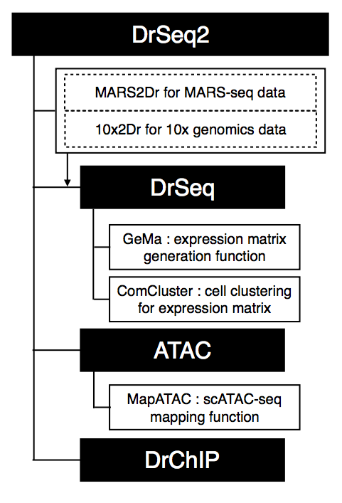
Pre-process pipeline: Dr.seq2 Introduction
Dr.seq2 is a QC and analysis pipeline for parallel single cell transcriptome and epigenome data. Dr.seq2 provides QC and analysis for three major data types: single cell transcriptome data (DrSeq part), Drop-ChIP data (DrChIP part) and scATAC-seq data (ATAC part).
For single cell RNA-seq data, two additional step-by-step functions are included:
1. expression matrix generation for amounts of single cell RNA-seq datasets (GeMa step) and
2. cell clustering and analysis for the single cell expression matrix (comCluster step).
For different single cell datasets, Dr.seq2 uses sequencing files in FASTQ format or SAM format as input with relevant command.
For transcriptome data, DrSeq uses two FASTQ files as standard input (one file contains the transcript reads and the other one contains cell barcode information.
Huo Xiao, Sheng’en Hu, Chengchen Zhao, and Yong Zhang. Dr. seq: a quality control and analysis pipeline for droplet sequencing. Bioinformatics (2016): btw174.
Credit : Zejie Lin
Notes:
Dr.seq2是一个平行单细胞转录组和表观基因组数据的QC和分析管道。
1.Dr.seq2支持不同类型的单细胞转录组学数据以及单细胞表观遗传组学数据；
2.Dr.seq2提供了详尽的质量控制报告以及细胞聚类分析结果。

Slide 35
Pre-process pipeline: Dr.seq2 workflow
1. raw data of parallel single cell transcriptome data
1. raw data of parallel single cell epigenome data
Drop-seq
in-Drop
MARS-seq
10x genomics
other SC data
scATAC-seq
Drop-ChIP
2. Reads level QC
2. Reads level QC
a.Reads quality
standardization
a.Reads quality
b.Reads nucleotide composition
b.Reads nucleotide composition
c.Reads GC content
Reads
barcodes
Reads
barcodes
c.Reads GC content
3. Bulk-cell level QC
3. Bulk-cell level QC
d.Reads alignment summary
Alignment
Alignment
e.Gene body coverage
d.ChIP region distribution
4. Individual-cell level QC
Peak calling on bulk reads
e.Peak distribution
d.Duplicate rate distribution
Expression matrix generation
f.Average profile
f.Covered gene number
4. Individual-cell level QC
g.Intron rate distribution
Highly variable genes selection and informative cells selection
Peak matrix generation
g.Distribution of reads number per cell
5. Cell-clustering level QC
Dimensional reduction:
PCA/t-SNE/SIMLR
Cell clustering:
h-cluster
5. Cell-clustering level QC
h.h-clustering based on peaks
h.Gap statistics score
Cell clustering:
dbscan/k-means
Post analysis
i.Silhouette score
i.cluster specific peaks
Huo Xiao, Sheng’en Hu, Chengchen Zhao, and Yong Zhang. Dr. seq: a quality control and analysis pipeline for droplet sequencing. Bioinformatics (2016): btw174.
Credit : Zejie Lin
Notes:
（1）原始测序片段层面。对二代测序数据的质量进行整体的评估；
（2）RNA文库建立层面。将测序数据进行序列回帖到特定基因组后，可以得到每个基因的表达值，此时通过一些指标进行细胞质量好坏的判断；
（3）单个细胞测序质量层面；
（4）细胞聚类层面。

Slide 36
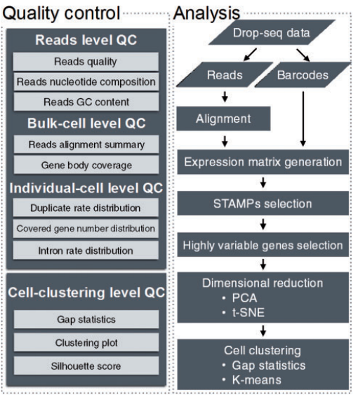
Pre-process pipeline: Dr.seq2 workflow
1. raw data of parallel single cell transcriptome data
Drop-seq
in-Drop
MARS-seq
10x genomics
other SC data
Dr.seq
2. Reads level QC
a.Reads quality
standardization
b.Reads nucleotide composition
c.Reads GC content
Reads
barcodes
3. Bulk-cell level QC
d.Reads alignment summary
Alignment
e.Gene body coverage
4. Individual-cell level QC
Expression matrix generation
d.Duplicate rate distribution
f.Covered gene number
g.Intron rate distribution
Highly variable genes selection and informative cells selection
5. Cell-clustering level QC
Dimensional reduction:
PCA/t-SNE/SIMLR
h.Gap statistics score
Cell clustering:
dbscan/k-means
i.Silhouette score
Huo Xiao, Sheng’en Hu, Chengchen Zhao, and Yong Zhang. Dr. seq: a quality control and analysis pipeline for droplet sequencing. Bioinformatics (2016): btw174.
Credit : Zejie Lin
Notes:
（1）原始测序片段层面。对二代测序数据的质量进行整体的评估；
（2）RNA文库建立层面。将测序数据进行序列回帖到特定基因组后，可以得到每个基因的表达值，此时通过一些指标进行细胞质量好坏的判断；
（3）单个细胞测序质量层面；
（4）细胞聚类层面。

Slide 37
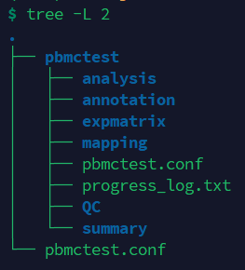
Pre-process
- DrSeq2 Preprocess
Tools：CDesk
Input command line:
CDesk scRNA preprocess drseq \
-i /mnt/linzejie/CDesk_test/data/2.scRNA/1.preprocess/10x \
-s susScr11 -o /mnt/linzejie/CDesk_test/result/2.scRNA/1.preprocess -t 100
Typical Parameter:
参数 | 描述 | 默认值
-i√ | fastq单细胞数据输入文件夹，格式: X_1.fastq X_2.fastq | -
-s√ | 物种信息 | mm10,hg38,rn7,galGal6,susScr11
-o√ | 输出结果存放位置 | -
-t | 指定线程数 | 8

Slide 38
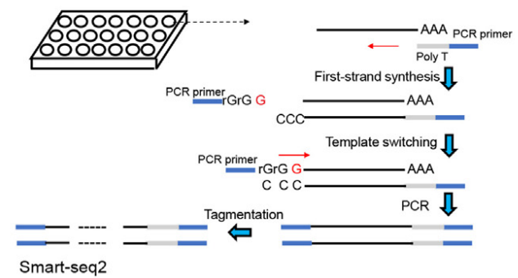
Pre-process pipeline: Smart-seq2 Introduction
Consistent with RNA-seq upstream analysis
Macosko et al., Highly Parallel Genome-wide Expression Profiling, Cell, 2015
Credit : Zejie Lin
Notes:
1、单细胞分选：Smart-seq使用流式细胞仪进行细胞分选，一次最大分选细胞通量为96个。
2、细胞裂解：在细胞裂解液中进行细胞裂解。
3、反转录（ 一链合成 ）：使用Oligo(dT) primer 对带有polyA尾的RNA( 主要是mRNA )进行反转录。由于使用了鼠源的反转录酶( Moloney Murine Leukemia Virus )进行反转录，所以会在cDNA链3'端加上三个C。
4、模板置换（ 二链合成 ）：该步使用TSO ( template-switching oligo )引物合成了cDNA的二链，从而置换了与一链cDNA互补的RNA。要注意的是TSO 3'端有三个G能与一链3'端的三个C互补，而最末端的+G是一个修饰过的G，能增加TSO的热稳定性，以及其与一链cDNA游离的3’端的互补的能力。TSO 还带有PCR所需的引物。
5、PCR扩增：该步进行轻度的cDNA富集，将cDNA扩增至ng级即可。
6、标记：利用改造后的高活性Tn5转座酶对DNA进行打断的同时将接头添加到cDNA的两端。标记完成后的DNA片段通常在200-600bp。
7、PCR富集&上级测序：在进行最后一次PCR扩增后，即可上机测序。
SMART-seq2是一种低通量单细胞测序法，提供全长转录组的定量，适合研究小细胞组（如差异isoform使用，低表达转录本的特征）。
10x Chromium是一种高通量方法，使用UMIs进行定量，适合研究高度异质组织和大量的细胞样本

Slide 39
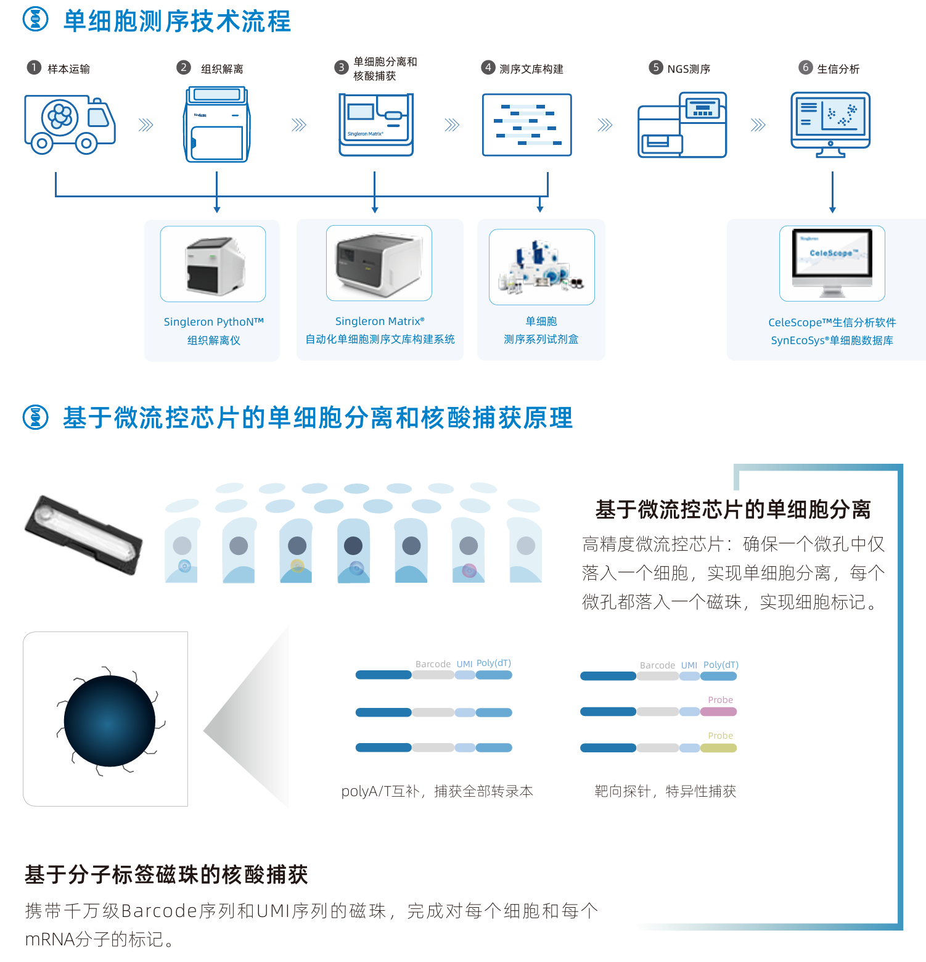

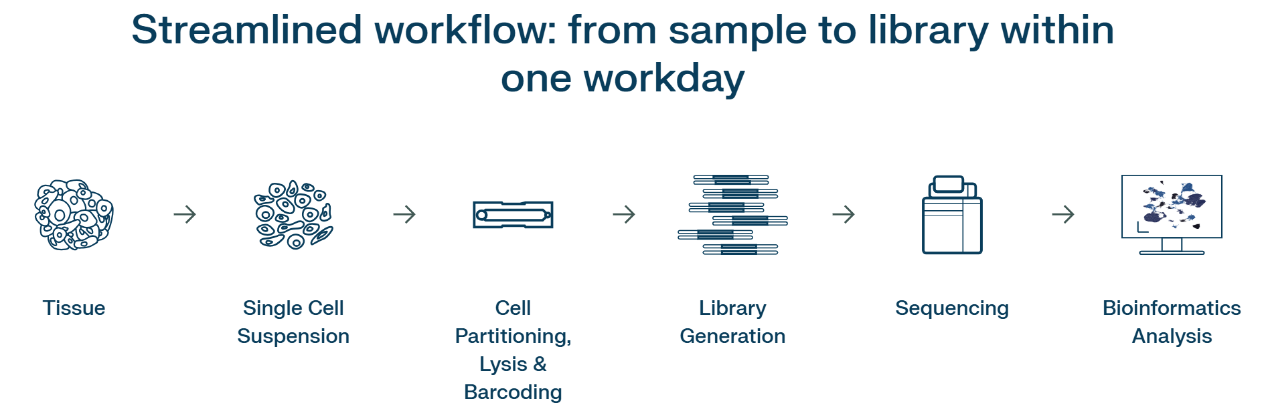
Pre-process pipeline: Singleron Introduction
Singleron is a series of single-cell system products developed based on an exclusive patent licensed from Yale University.
Singleron Biotechnologies (https://www.singleron.bio)
Credit : Zejie Lin
Notes:
新格元基于耶鲁大学独家授权专利开发了系列单细胞系统产品

Slide 40
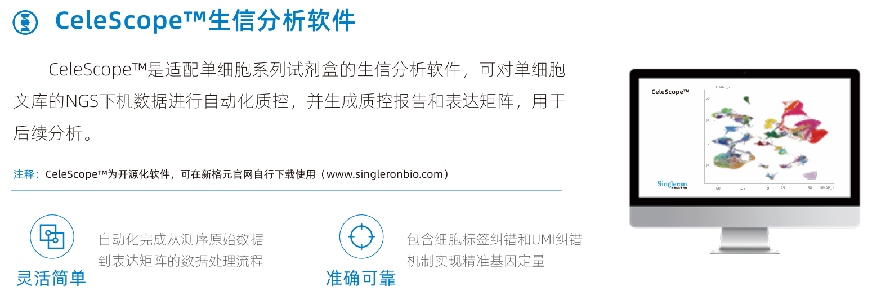
Pre-process pipeline: Singleron Introduction
CeleScope™ bioinformatics analysis software
Open-source bioinformatics software developed for processing sequencing data generated by Singleron’s single-cell product series.
Starting from raw FASTQ data from next-generation sequencing, provides functions including data demultiplexing, alignment, quantification, expression matrix generation, and clustering.
Offers diverse analysis pipelines, including single-cell transcriptomics, immune repertoire profiling, transcriptional dynamics, multi-omics, single-cell targeted sequencing, and glycosylation analysis.
Data input
paired-ended FASTQ files from sequencing
Data output
Bam file and gene expression matrix files for downstream analysis
Singleron Biotechnologies (https://www.singleron.bio)
Credit : Zejie Lin
Notes:
CeleScope是一款由新格元生物科技有限公司自主开发的，用于处理新格元单细胞系列产品测序数据的开源生信软件，应用于分析新格元各类单细胞测序数据的生物信息流程。
可从二代测序下机的原始fastq数据开始处理，包含数据拆分、比对、定量、生成表达矩阵、分群等功能。
CeleScope的分析功能十分丰富，已经集成单细胞转录组、免疫组库、转录动态、多样同测、单细胞靶向测序、糖基化等多种分析流程。

Slide 41
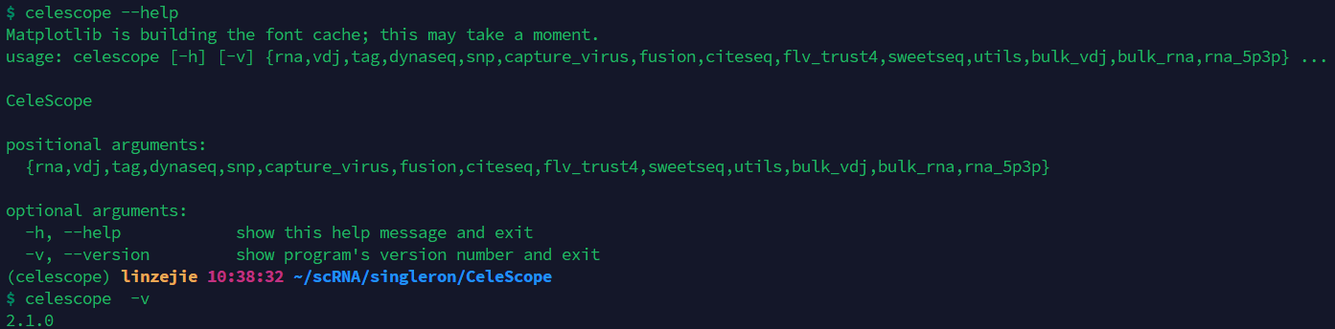
Pre-process pipeline: CeleScope Installation
1. Clone the CeleScope repository from GitHub
git clone https://github.com/singleron-RD/CeleScope.git
2. Create CeleScope conda environment
conda create -n celescope -y --file conda_pkgs.txt
3. Install CeleScope
conda activate celescope
pip install celescope #or try other mirrors
pip install celescope --default-timeout=100 -i https://pypi.tuna.tsinghua.edu.cn/simple
4. Check
which celescope
celescope --help
celescope -v
Credit : Zejie Lin
Notes:
rna 用于分析新格元 GEXSCOPE®单细胞转录组试剂盒建库测序下机的单细胞（核）转录组数据.
vdj 用于分析新格元 GEXSCOPE®单细胞免疫组试剂盒建库测序下机的单细胞免疫组数据.
tag 用于分析单细胞多样同测试剂盒CLindex®产生的数据，可以分析单细胞转录组混样数据、单细胞免疫组混样数据.
dynaseq 用于分析新格元 DynaSCOPE®转录动态试剂盒建库测序的下机数据.
snp 用于分析新格元FocuSCOPE®单细胞肺癌靶向试剂盒建库测序的下机数据.
capture_virus 用于分析新格元 FocuSCOPE®单细胞EBV病毒靶向试剂盒建库测序的下机数据。

Slide 42
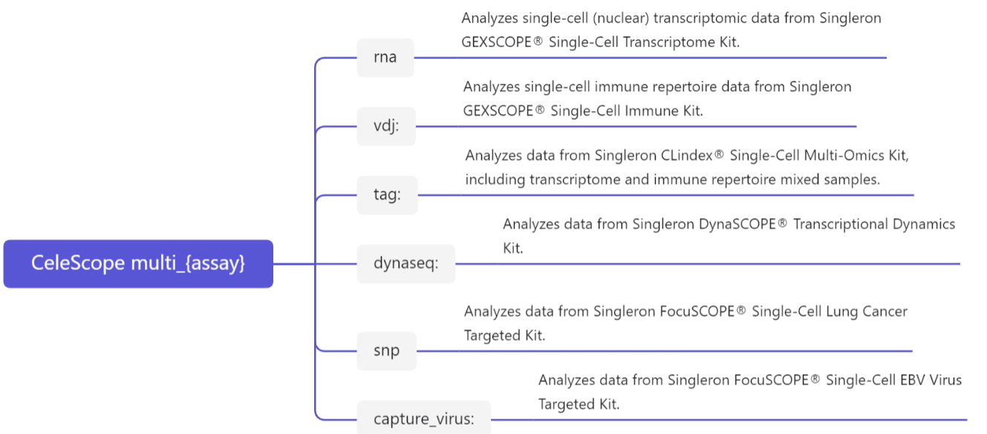
Pre-process pipeline: CeleScope multiple assay analysis
multi_rna
usage: rna multi-samples [-h] --mapfile MAPFILE [--mod {sjm,shell}]
[--queue QUEUE] [--rm_files] [--steps_run STEPS_RUN]
[--outdir OUTDIR] [--thread THREAD] [--debug]
[--chemistry {auto,scopeV1,scopeV2.0.0,scopeV2.0.1,scopeV2.1.0,scopeV2.1.1,scopeV2.2.1,scopeV3.0.1,flv_rna,flv,customized}]
[--pattern PATTERN] [--whitelist WHITELIST]
[--linker LINKER] [--lowQual LOWQUAL]
[--lowNum LOWNUM] [--nopolyT] [--noLinker]
[--allowNoPolyT] [--allowNoLinker] [--output_R1]
[--gzip] [--adapter_fasta ADAPTER_FASTA]
[--minimum_length MINIMUM_LENGTH]
[--nextseq_trim NEXTSEQ_TRIM] [--overlap OVERLAP]
[--insert INSERT] [--cutadapt_param CUTADAPT_PARAM]
[--outFilterMatchNmin OUTFILTERMATCHNMIN]
[--out_unmapped] [--STAR_param STAR_PARAM]
[--outFilterMultimapNmax OUTFILTERMULTIMAPNMAX]
[--starMem STARMEM] [--gtf_type {exon,gene}]
[--featureCounts_param FEATURECOUNTS_PARAM]
[--expected_cell_num EXPECTED_CELL_NUM]
[--cell_calling_method {auto,EmptyDrops_CR}]
--genomeDir GENOMEDIR [--save_rds]
Credit : Zejie Lin
Notes:
rna 用于分析新格元 GEXSCOPE®单细胞转录组试剂盒建库测序下机的单细胞（核）转录组数据.
vdj 用于分析新格元 GEXSCOPE®单细胞免疫组试剂盒建库测序下机的单细胞免疫组数据.
tag 用于分析单细胞多样同测试剂盒CLindex®产生的数据，可以分析单细胞转录组混样数据、单细胞免疫组混样数据.
dynaseq 用于分析新格元 DynaSCOPE®转录动态试剂盒建库测序的下机数据.
snp 用于分析新格元FocuSCOPE®单细胞肺癌靶向试剂盒建库测序的下机数据.
capture_virus 用于分析新格元 FocuSCOPE®单细胞EBV病毒靶向试剂盒建库测序的下机数据。

Slide 43


Pre-process pipeline: CeleScope rna pipeline
Credit : Zejie Lin
Notes:
mkref：创建基因组参考目录.
sample：提供样本信息，包括样本ID，分析类型，scope 试剂版本和 celescope 软件版本.
barcode：基于 read1 序列信息过滤，提取并矫正 barcode，将矫正后的 barcode 和原始的 UMI 序列添加到 read2 的 ID 中.
cutadapt：对数据进行质控.
star：调用 STAR 将 reads2 序列比对到基因组上.
featureCounts：FeatureCounts 根据 bam 文件将序列比对的结果计数到细胞内.
count：进行UMI计数以及细胞数目评估 (cell calling), 最终输出表达矩阵.
analysis：分析表达矩阵，包括线粒体统计、tSNE 分群等.

Slide 44

Pre-process pipeline: CeleScope rna pipeline - mkref
celescope rna mkref \
--genome_name gg_ncbi \
--fasta /mnt/zhaochengchen/Data/Gal6/galGal6.fa \
--gtf /mnt/zhaochengchen/Data/Gal6/galGal6.ncbiRefSeq.gtf \
--mt_gene_list Gallus_gallus.ncbi.MTGenes.txt \ # Mitochondria gene list file name
--thread 10
Credit : Zejie Lin

Slide 45
Pre-process pipeline: CeleScope rna pipeline - multi_rna
1. Prepare a tab-split mapfile file containing path information for sequencing data
Mapfile is a tab-delimited text file with as least three columns.
Each line of mapfile represents paired-end fastq files.
1st column: Fastq file prefix.
2nd column: Fastq file directory path.
3rd column: Sample name, which is the prefix of all output files.
$cat rna.mapfile
D0 /mnt/zhaochengchen/Work/OTHER/03.WXM/3.WXM_cPGCscRNAseq/data/D0 D0
D4 /mnt/zhaochengchen/Work/OTHER/03.WXM/3.WXM_cPGCscRNAseq/data/D4 D4
2. Build a shell script for celescope rna analysis with multi_rna
multi_rna \
--mapfile /mnt/zhaochengchen/Work/OTHER/03.WXM/3.WXM_cPGCscRNAseq/result/0.mapping/rna.mapfile \
--genomeDir /mnt/zhaochengchen/Work/OTHER/03.WXM/3.WXM_cPGCscRNAseq/result/0.mapping/gg_ncbi \
--thread 10 \
--mod shell \ # Which type of script to generate
--starMem 100 # Maximum memory that STAR can use
multi_rna is the software that generates the CeleScope RNA analysis script.
Integrates most of the parameters from the 8 commands.
Generate a {sample}.sh, {sample} corresponds to the 3rd column in the mapfile.
Credit : Zejie Lin
Notes:
multi_rna 是生成 CeleScope rna 分析脚本的软件
整合了八个指令中的大部分参数
该指令生成的脚本用 sh 运行后，会生成一个包含 {sample}.sh 文件的文件夹 (文件夹名为shell) ，{sample} 对应 mapfile 第三列翻译

Slide 46
Pre-process pipeline: CeleScope rna pipeline - multi_rna
3. Run the shell script generated by multi_rna
nohup bash ./shell/D0.sh > D0.log
nohup bash ./shell/D4.sh > D4.log
$ cat ./shell/D0.sh
celescope rna sample --outdir .//D0/00.sample --sample D0 --assay rna --thread 10 --chemistry auto --fq1 /data/zhaochengchen/Work/OTHER/03.WXM/8.WXM_cPGCscRNAseq/data/D0/D0_1.fq.gz
celescope rna barcode --outdir .//D0/01.barcode --sample D0 --assay rna --thread 10 --chemistry auto --lowNum 2 --gzip --fq1 /data/zhaochengchen/Work/OTHER/03.WXM/8.WXM_cPGCscRNAseq/data/D0/D0_1.fq.gz --fq2 /data/zhaochengchen/Work/OTHER/03.WXM/8.WXM_cPGCscRNAseq/data/D0/D0_2.fq.gz
celescope rna cutadapt --outdir .//D0/02.cutadapt --sample D0 --assay rna --thread 10 --gzip --minimum_length 20 --nextseq_trim 20 --overlap 10 --insert 150 --fq .//D0/01.barcode/D0_2.fq.gz
celescope rna star --outdir .//D0/03.star --sample D0 --assay rna --thread 10 --genomeDir /data/zhaochengchen/Work/OTHER/03.WXM/8.WXM_cPGCscRNAseq/result/0.mapping/gg_ncbi --outFilterMultimapNmax 1 --starMem 100 --fq .//D0/02.cutadapt/D0_clean_2.fq.gz
celescope rna featureCounts --outdir .//D0/04.featureCounts --sample D0 --assay rna --thread 10 --gtf_type exon --genomeDir /data/zhaochengchen/Work/OTHER/03.WXM/8.WXM_cPGCscRNAseq/result/0.mapping/gg_ncbi --input .//D0/03.star/D0_Aligned.sortedByCoord.out.bam
celescope rna count --outdir .//D0/05.count --sample D0 --assay rna --thread 10 --genomeDir /data/zhaochengchen/Work/OTHER/03.WXM/8.WXM_cPGCscRNAseq/result/0.mapping/gg_ncbi --expected_cell_num 3000 --cell_calling_method auto --bam .//D0/04.featureCounts/D0_name_sorted.bam --force_cell_num None
celescope rna analysis --outdir .//D0/06.analysis --sample D0 --assay rna --thread 10 --genomeDir /data/zhaochengchen/Work/OTHER/03.WXM/8.WXM_cPGCscRNAseq/result/0.mapping/gg_ncbi --matrix_file .//D0/05.count/D0_matrix_10
Credit : Zejie Lin
Notes:
multi_rna 是生成 CeleScope rna 分析脚本的软件
整合了八个指令中的大部分参数
该指令生成的脚本用 sh 运行后，会生成一个包含 {sample}.sh 文件的文件夹 (文件夹名为shell) ，{sample} 对应 mapfile 第三列翻译

Slide 47





Pre-process pipeline: CeleScope rna pipeline result
Obtain a web report for the single-cell transcriptome which includes:
Sample and software basic information in the quality control report
Data quality control information
Genome alignment information
Cell and gene quantification details
Preliminary dimensionality reduction and clustering results
Differential analysis between subgroups
The obtained expression matrix can be uploaded to the SynEcoSys single-cell clinical database (https://www.synecosys.cn/) for cell annotation and analysis
Singleron Biotechnologies (https://www.singleron.bio)
Credit : Zejie Lin
Notes:
当我们运行完以后，就可以得到一个单细胞转录组的网页报告。
质控报告的样本和软件的基本信息
数据质控信息
基因组比对信息
细胞与基因定量情况
初步降维聚类结果
亚群间差异分析

Slide 48

Pre-process
- Singleron Preprocess
Tools：CDesk
Input command line:
CDesk scRNA preprocess singleron \
-i /mnt/linzejie/CDesk_test/data/2.scRNA/1.preprocess/celescope \
-s galGal6 -o /mnt/linzejie/CDesk_test/result/2.scRNA/1.preprocess -t 100
Typical Parameter:
参数（√必须参数） | 描述 | 默认值
-i√ | fastq.gz/fq.gz单细胞数据输入文件夹，格式: X_1.fastq(fq).gz, X_2.fastq(fq).gz | -
-s√ | 物种信息 | mm10,hg38,rn7,galGal6,susScr11
-o√ | 输出结果存放位置 | -
-t | 指定线程数 | 8

Slide 49

Pre-process
- Huada Preprocess
Tools：CDesk
Input command line:
CDesk scRNA preprocess dnbc \
-i /mnt/linzejie/CDesk_test/data/2.scRNA/1.preprocess/huada_test.tsv \
-s hg38 -o /mnt/linzejie/CDesk_test/result/2.scRNA/1.preprocess -t 100
Typical Parameter:
参数（√必须参数） | 描述 | 默认值
-i√ | 指定输入tsv文件 | -
-s√ | 物种信息 | mm10,hg38,rn7,galGal6,susScr11
-o√ | 输出结果存放位置 | -
-t | 指定线程数 | 8

Slide 50
Quality control
Droplet-based scRNA-seq (Drop-seq, 10x)
Dr.seq
CellRanger
Microwell-based scRNA-seq (Smart-seq)
RNA-seq pipeline
Credit : Wei Shi

Slide 51

Quality control
Dr.seq
Reads quality is one of the basic reads level quality control methods.
Color in the heatmap represented frequency of this quality score observed at this position.
Red represented higher frequency while blue was lower frequency.
Credit : Wei Shi

Slide 52

Quality control
Dr.seq
We assessed the nucleotide composition bias of a sample.
The proportion of four different nucleotides was calculated at each position of reads.
Theoretically four nucleotides had similar proportion at each position of reads.
You may observe higher A/T count at 3’end of reads because of the 3’end polyA tail generated in sequencing cDNA libaray, otherwise the A/T count should be closer to C/G count.
Credit : Wei Shi

Slide 53

Quality control
Dr.seq
Distribution of GC content of each read. This module measures the general quality of the library.
If the distribution looks different from a single bell(too sharp or too broad) then there may be a problem with the library.
Sharp peaks on an otherwise smooth distribution are normally the result of a specific contaminant (adapter dimers for example), which may well be picked up by the overrepresented sequences module.
Broader peaks may represent contamination with a different species.
Credit : Wei Shi

Slide 54

Quality control
Dr.seq
Aggregate plot of reads coverage on all genes. This module measures the general quality of Drop-seq data.
Theoretically we observe a unimodal(single bell) distribution, but for Drop-seq sample an enrichment at 3’end is observed due to library preparation using oligo-dT primers.
In any case you should observed a smooth distritbuion. If loss of reads or spike were observed in certain part of gene body (e.g. middle or 3’end of gene body), poor quality of your library was indicated.
Credit : Wei Shi

Slide 55

Quality control
Dr.seq
Drop-seq technology has an innate advantage of detect duplicate reads and amplification bias because of the barcode and UMI information.
This module displays the distribution of duplicate rate in each cell barcode and helps to discard cell barcodes with low duplicate rate.
We plotted the distribution of duplicate rate in each cell barcode.
Credit : Wei Shi

Slide 56

Quality control
Dr.seq
Reads duplicate rate versus cumulative covered gene numbers.
This module measures whether each of your single cell was sequenced and was clearly separated from empty cell barcodes.
Cell barcodes were ranked by the number of covered genes.
The duplicate rate (y-axis, left side) was plotted as a function of ranked cell barcode. Red curve represented the number of genes covered by top N cell barcodes (y-axis, right side). N was showed by x-axis.
Theoretically you will observed a “knee” on your cumulative curve (slope = 1 on the curve) and the cutoff of your selected STAMPs (dash line) should be close to the “knee”.
Credit : Wei Shi

Slide 57

Quality control
Dr.seq
Covered gene number was plotted as a function of the number of UMI (i.e. unique read).
This module measures the quality of Drop-seq experiment and helps to distinguish STAMPs from empty cell barcodes.
We observed a clearly different pattern for two groups of cell barcodes with different reads duplicate rate (blue dots versus red and purple dots). Purple dots represented the selected STAMPs for the cell-clustering analysis. By default we select STAMPs with 1000 gene covered after discarding low duplicate cell barcodes.
Credit : Wei Shi

Slide 58

Quality control
Dr.seq
Histogram of covered gene number of selected STAMPs.
The module tell you whether the selected STAMPs have sufficient reads coverage. By default Dr.seq select STAMPs with cell barcodes with >= 1000 genes covered.
If you select STAMPs with highest reads count (“select cell measure” = 2), then you should check this figure to make sure the STAMPs you select have enough gene covered.
Credit : Wei Shi

Slide 59

Quality control
Dr.seq
Intron rate is an effective method to measure the quality of a RNA-seq sample.
We plotted a histogram of intron rate of every STAMP barcodes to check whether reads from each STAMPs enriched in the exon region.
High intron rate (e.g. >= 30%) indicates low quality of cDNA in each STAMPs (the low quality could be caused by different problem, for example contaminant).
We suggest redo the experiment if most of selected STAMPs have high intron rate and low covered gene number.
Credit : Wei Shi

Slide 60



Quality control
CellRanger
Sequencing Saturation
Better between 60% and 80%. Higher saturation indicates that most of the useful information (genes, transcripts) has already been captured, and additional sequencing depth will not significantly increase new data.
Credit : Wei Shi

Slide 61

Quality control
CellRanger
Reads Mapped Confidently to Transcriptome
Ideally, more than 30%.
Reads Mapped Confidently to Exonic Regions
Typically, 80%-90% of reads mapped to exonic regions indicate good data quality.
Credit : Wei Shi

Slide 62

Quality control
CellRanger
Fraction of Reads in Cells
Ideally, it should be above 70%-80%.
Credit : Wei Shi

Slide 63
Quality control
RNA-seq pipeline
Please refer to the Quality control section in RNA-seq data processing.
Credit : Wei Shi

Slide 64
Cell clustering
Dimensional reduction
PCA
t-SNE
UMAP
Seurat (R)
Scanpy (Python)
Credit : Zejie Lin, Tianci Kong

Slide 65
Cell clustering: Dimensional reduction
Too much data
Normally limited to two (x, y) or three (x, y, z) progression visualization
Dimensionality Reduction Algorithms: The foundation of high-dimensional data visualization, aiming to map data from high-dimensional space to low-dimensional space
3 main dimensional reduction methods in scRNA:
Principal Component Analysis (PCA)
t-Distributed Stochastic Neighbor Embedding (t-SNE)
Uniform Manifold Approximation and Projection (UMAP)
Credit : Zejie Lin, Tianci Kong
Notes:
实现高维数据可视化的理论基础是基于降维算法。
降维算法一般分为两类：那些寻求在数据中保存距离结构的，以及倾向于保存局部距离而不是全局距离的。
PCA[1]、MDS[2]等算法属于前者，t-SNE[3,4]、diffusion maps[5]等算法都属于后者。

Slide 66

Cell clustering: Dimensional reduction - PCA
A linear dimension reduction algorithm
Projects every data point from high-dimensional space to low-dimensional space such that the variance of newly projected data (or information held) is maximum
Builds a recipe for converting large amounts of data into a single value, called a Principle Component (PC), eg:
PC = (GeneA*10)+(GeneB*3)+(GeneC*-4)+(GeneD*-20)…
https://kindsonthegenius.com/blog/dimensionality-reduction-and-principal-component-analysis-pca/
Credit : Zejie Lin, Tianci Kong
Notes:
PCA(Principal Component Analysis)，即主成分分析方法，是一种使用最广泛的数据降维算法。
PCA的主要思想是将n维特征映射到k维上，这k维是全新的正交特征也被称为主成分，是在原有n维特征的基础上重新构造出来的k维特征。
PCA的工作就是从原始的空间中顺序地找一组相互正交的坐标轴，新的坐标轴的选择与数据本身是密切相关的。

Slide 67

Cell clustering: Dimensional reduction - t-SNE
A nonlinear dimensionality reduction algorithm
A probabilistic dimensionality reduction method that calculates pairwise similarities between samples in high-dimensional space and then reconstructs these similarities in a low-dimensional space using probability distributions.
Key Steps:
Compute Pairwise Similarities: Calculate pairwise similarities between samples in high-dimensional space using a Gaussian distribution.
Construct Probability Distributions: Form probability distributions based on the similarities for both high-dimensional and low-dimensional spaces.
Minimize KL Divergence: Use gradient descent to minimize the Kullback-Leibler (KL) divergence between the high-dimensional and low-dimensional probability distributions, optimizing the positions of points in the low-dimensional space.
T-SNE embeddings of MNIST dataset
https://en.wikipedia.org/wiki/T-distributed_stochastic_neighbor_embedding
Credit : Zejie Lin, Tianci Kong
Notes:
一种非线性降维算法
一种概率降维方法，该方法在高维空间中计算样本之间的成对相似度，然后在低维空间中使用概率分布重建这些相似度。关键步骤：
计算成对相似度：使用高斯分布计算高维空间中样本之间的成对相似度。构造概率分布：根据高维和低维空间的相似度形成概率分布。最小化KL散度：使用梯度下降最小化高维和低维概率分布之间的Kullback-Leibler （KL）散度，优化低维空间中的点位置。

Slide 68

Cell clustering: Dimensional reduction - UMAP
A non-linear dimensionality reduction method that focuses on preserving both local and global structures in high-dimensional data while mapping it into a lower-dimensional space.
Key Steps:
Construct a Graph of Neighbors: UMAP starts by constructing a graph where each data point is connected to its nearest neighbors in the high-dimensional space.
Compute Local Relationships: Similar to t-SNE, UMAP captures local relationships using a probabilistic model but also ensures that global data structures are preserved.
Optimize Low-Dimensional Embedding: The algorithm uses optimization techniques (such as stochastic gradient descent) to minimize a cost function that preserves both local and global structures in the lower-dimensional space.
UMAP embeddings of MNIST dataset
UMAP: Uniform Manifold Approximation and Projection for Dimension Reduction)
Credit : Zejie Lin, Tianci Kong
Notes:
一种非线性降维方法，侧重于保留高维数据中的局部和全局结构，同时将其映射到低维空间。
关键步骤:
构建邻居图：UMAP首先构建一个图，其中每个数据点都连接到高维空间中最近的邻居。
计算本地关系：与t-SNE类似，UMAP使用概率模型捕获本地关系，但也确保保留全局数据结构。
优化低维嵌入：该算法使用优化技术（如随机梯度下降）最小化成本函数，在低维空间中保留局部和全局结构。

Slide 69

Cell clustering: Dimensional reduction - Comparison
t-SNE
Higher computational complexity,time-consuming processing large datasets
Avoid overcrowding, could distinguish overlapping clusters
PCA
Linear,suitable for exploring linear relationships between genes
Relatively simple and fast.
Worst cell clustering effect
UMAP
More efficient and better effect than t-SNE when handling large datasets
Provide useful and intuitive features, retains more global structure, particularly the continuity of cell subset
Non-linear, ideal for uncovering non-linear structures in gene expression patterns and complex relationships between cells
Minimal differences in performance in small datasets
https://www.bio-equip.com/showarticle.asp?id=453107027
Credit : Zejie Lin, Tianci Kong
Notes:
线性方法，适合用于探索基因之间的线性关系
计算相对简单且快速
非线性，可用于揭示基因表达模式的非线性结构和细胞间的复杂关系
计算复杂度较高，处理大型数据集非常耗时

Slide 70


Cell clustering: scRNA analysis tools - Seurat & Scanpy
Seurat is an R package designed for QC, analysis, and exploration of single-cell RNA-seq data. Seurat aims to enable users to identify and interpret sources of heterogeneity from single-cell transcriptomic measurements, and to integrate diverse types of single-cell data.
Scanpy is a scalable toolkit for analyzing single-cell gene expression data built jointly with anndata. It includes preprocessing, visualization, clustering, trajectory inference and differential expression testing. The Python-based implementation efficiently deals with datasets of more than one million cells.
Credit : Zejie Lin, Tianci Kong

Slide 71
Cell clustering: Seurat standard pre-processing workflow
Load Data
QC
Normalize
Linear dimensional reduction
Scale
Feature Selection
Cluster cells
Non-linear dimensional reduction
Find cluster biomarkers
Annotate
Credit : Zejie Lin, Tianci Kong

Slide 72
Cell clustering: Scanpy standard pre-processing workflow
Load Data
QC
Normalize
Dimensional reduction
Scale
Feature Selection
Compute the neighborhood graph
Embed the neighborhood graph
Cluster the neighborhood graph
Annotate
Find marker genes
Credit : Zejie Lin, Tianci Kong
Notes:
线性方法，适合用于探索基因之间的线性关系
计算相对简单且快速
非线性，可用于揭示基因表达模式的非线性结构和细胞间的复杂关系
计算复杂度较高，处理大型数据集非常耗时

Slide 73






Cell clustering: Seurat vs Scanpy
Seurat
Scanpy
Scanpy guide, by Scanpy development team
Credit : Zejie Lin, Tianci Kong
Notes:
线粒体基因比例高表明细胞质量差，可能是因为穿孔细胞的细胞质RNA丢失。其理由是，线粒体比单个转录分子更大，并且不太可能通过细胞膜的撕裂逃脱。

Slide 74






Clustering
- Clustering
Tools：CDesk
Input command line:
CDesk scRNA cluster \
-i /mnt/linzejie/CDesk_test/data/2.scRNA/2.clustering/hg19 \
-o /mnt/linzejie/CDesk_test/result/2.scRNA/2.clustering/seurat \
-n test --mode seurat(scanpy)
Typical Parameter:
参数 | 描述 | 默认值
-i√ | 单细胞输入数据(10x文件夹,txt/csv/txv.gz,h5,rds/h5ad) | -
-n√ | 结果文件夹前缀 | -
-o√ | 输出结果存放位置 | -
--mode√ | 分析方式（seurat/scanpy） | -
--min_cells | 过滤最少细胞阈值 | 3
--min_features | 过滤最少基因阈值 | 200
--nFeature_RNA_min | RNA feature过滤最小值 | 200
--nFeature_RNA_max | RNA feature过滤最大值 | 2500
--mt_percent | 线粒体百分比过滤阈值 | 5
--variable_features | 高变基因数选择 | 2000
--dim_prefer | 维度选择 | 30
--res | 降维聚类分辨率 | 1

Slide 75
Cell type annotation
Manual
Expression pattern of given genes
Annotation
Automated
Credit : Wei Shi

Slide 76
Cell type annotation
Expression pattern of given genes（Manual）
(1) Create a variable for marker genes of a specific category.
(2) Plot the distribution of these marker genes in the figure using a scatter plot and a dot plot.
Input command line:
# R
markers <- c('Gata6', 'Gata4', 'Sox17', 'Sox7', 'Snai1', 'S100g', 'H19', "Col4a1", "Col4a2", "Lama1", "Pth1r", "Sparc", "Cited1", "Lamb1", "Lamc1", 'Serpinh1', 'Rbp4', 'Ttr', 'Srgn', 'Plod2', 'Aqp8', 'Tfpi', 'S100a1', 'Dab2', 'Cdkn1c') #PaE
p <- FeaturePlot(seurat_object, features = markers, ncol = 3)
ggsave("~/home/path/PaE-marker_gene_distribution.pdf", p, width = length(markers)*1.5+2, height = length(markers)*2+2, limitsize = FALSE)
p <- DotPlot(seurat_object, features = markers) + RotatedAxis()
ggsave("~/home/path/PaE-marker_gene_dot.pdf", p, width = 14, height = 6)
Credit : Wei Shi

Slide 77
Cell type annotation
Annotation（Manual）
(1) Determine the cluster type of the cell type based on the distribution plot or dot plot.
Input command line:
# R
seurat_object$celltype.main <- recode(seurat_object@meta.data$umap_clusters,
"0" = "ICM",
"1" = "VE",
"2" = "VE",
"3" = "Morula",
"4" = "VE",
"5" = "TE",
"6" = "PrE",
"7" = "Morula",
"8" = "PrE",
"9" = "ICM",
"10" = "ICM",
"11" = "PrE",
"12" = "Epiblast")
Credit : Wei Shi

Slide 78


Cell type annotation
CellMarker 2.0（Automated）
First step
Second step
Reference:
https://www.10xgenomics.com/analysis-guides/web-resources-for-cell-type-annotation
Credit : Wei Shi

Slide 79


Cell type annotation
ACT（Automated）
First step
Second step
Reference:
https://genomemedicine.biomedcentral.com/articles/10.1186/s13073-023-01249-5
Credit : Wei Shi

Slide 80
Cell type annotation
scPred（Automated）
scPred is a general method to classify cells based on a low-dimensional representation of gene expression (e.g. PCA).
# R
library("scPred")
library("Seurat")
library("magrittr")
reference <- scPred::pbmc_1
query <- scPred::pbmc_2 # The data that needs to be annotated
# Preprocessing
reference <- reference %>%
NormalizeData() %>%
FindVariableFeatures() %>%
ScaleData() %>%
RunPCA() %>%
RunUMAP(dims = 1:30)
DimPlot(reference, group.by = "cell_type", label = TRUE, repel = TRUE)
# Training classifiers with scPred
reference <- getFeatureSpace(reference, "cell_type")
reference <- trainModel(reference)
# Cell classification
query <- NormalizeData(query)
query <- scPredict(query, reference)
DimPlot(query, group.by = "scpred_prediction", reduction = "scpred")
FeaturePlot(query, c("scpred_B.cell", "scpred_CD4.T.cell", "scpred_CD8.T.cell",
"scpred_cMono", "scpred_ncMono", "scpred_Plasma.cell",
"scpred_cDC", "scpred_pDC"))
Reference:
https://github.com/powellgenomicslab/scPred
Credit : Wei Shi

Slide 81
Cell type annotation
TransferLabel（Automated）
scPred is a general method to classify cells based on a low-dimensional representation of gene expression (e.g. PCA).
# R
library("scPred")
library("Seurat")
library("magrittr")
# read data
ref <- readRDS("~/home/path/reference.rds")
qry <- readRDS("~/home/path/query.rds")
DefaultAssay(ref) <- "RNA"
DefaultAssay(qry) <- "RNA"
common_features <- intersect(rownames(ref), rownames(qry))
ref <- subset(ref, features = common_features)
qry <- subset(qry, features = common_features)
anchors <- FindTransferAnchors(
reference = ref,
query = qry,
dims = 1:50,
reduction = "pcaproject",
reference.reduction = "pca",
features = common_features
)
# Transfer cell type annotations
qry_celltype_main <- TransferData(
anchorset = anchors,
refdata = ref@meta.data$celltype,
dims = 1:50,
k.weight = 20
)
# Add predicted cell type and embryonic period to metadata
qry@meta.data$PredCelltype <- qry_celltype_main$predicted.id
Credit : Wei Shi

Slide 82

Cell type annotation
- Cell type annotation (Custom)
Tools：CDesk
Input command line:
CDesk scRNA annotation marker \
-i /mnt/linzejie/CDesk_test/data/2.scRNA/3.annotation/qry_data.rds \
--marker /mnt/linzejie/CDesk_test/data/2.scRNA/3.annotation/marker_info.csv \
--meta umap_clusters \
-o /mnt/linzejie/CDesk_test/result/2.scRNA/3.annotation/marker
Typical Parameter:
参数 | 描述 | 默认值
-i√ | 单细胞输入数据(rds格式) | -
--marker√ | 注释类群基因信息文件夹(csv) | -
-o√ | 输出结果存放位置 | -
--meta√ | seurat对象的meta.data中使用的类群依据 | -
--cluster | 结果降维可视化(umap/tsne) | umap
--expression_thre | 平均表达阈值 | 1.5
--percentage_thre | 表达量大于0的阈值 | 0.7
--marker_thre | 两个条件都满足的平均比例阈值 | 0.7

Slide 83

Cell type annotation
- Cell type annotation (TransferLabel)
Tools：CDesk
Input command line:
CDesk scRNA annotation transfer \
--query /mnt/linzejie/CDesk_test/data/2.scRNA/3.annotation/qry_data.rds \
--ref /mnt/linzejie/CDesk_test/data/2.scRNA/3.annotation/ref_data.rds \
--meta celltype_annotation_20210517 \
-o /mnt/linzejie/CDesk_test/result/2.scRNA/3.annotation/transfer
Typical Parameter:
参数 | 描述 | 默认值
--query√ | 需要注释的单细胞输入数据(rds格式) | -
--ref√ | 参考单细胞数据(rds格式) | -
-o√ | 输出结果存放位置 | -
--meta√ | seurat的meta.data中使用的类群依据 | -
--cluster | 结果降维可视化(umap/tsne) | umap
--nfeatures | 使用的高变基因数 | 2000
--dims | 使用的降维PC维度 | 30

Slide 84

Marker gene detection
function
plot
rank
Credit : Tiancheng Kong

Slide 85

Marker gene detection
- Marker gene detection (All group)
Tools：CDesk
Input command line:
CDesk scRNA marker all \
-i /mnt/linzejie/CDesk_test/data/2.scRNA/4.marker/D1.filt.rds \
-o /mnt/linzejie/CDesk_test/result/2.scRNA/4.marker/all \
--meta tsne_clusters --width 16 --height 14 -m 0.25 -p 0.05 -f 0.5
Typical Parameter:
参数 | 描述 | 默认值
-i√ | 单细胞输入数据(rds格式) | -
--meta√ | seurat对象的meta.data中使用的类群依据 | -
-o√ | 输出结果存放位置 | -
-f | logFC阈值 | 0.5
-m | 最小表达细胞比例 | 0.25
-p | padj阈值 | 0.05
--width | 画图宽度 | 16
--height | 画图高度 | 14

Slide 86

Marker gene detection
- Marker gene detection (Between 2 group)
Tools：CDesk
Input command line:
CDesk scRNA marker 2group \
-i /mnt/linzejie/CDesk_test/data/2.scRNA/4.marker/D1_EMT.filt.rds \
-o /mnt/linzejie/CDesk_test/result/2.scRNA/4.marker/2group \
--meta umap_clusters --type1 3 --type2 7 -f 0.5 -p 0.05 -m 0.25
Typical Parameter:
参数 | 描述 | 默认值
-i√ | 单细胞输入数据(rds格式) | -
--meta√ | seurat的meta.data中使用的类群依据 | -
-o√ | 输出结果存放位置 | -
--type1√ | 指定的第一个类群 | -
--type2√ | 指定的第二个类群 | -
-f | logFC阈值 | 0.5
-m | 最小表达细胞比例 | 0.25
-p | padj阈值 | 0.05
--width | 图宽 | 16
--height | 图高 | 14

Slide 87
Trajectory inference
Monocle
CStreet
DiffusionMap
RNA velocity
Credit : Zejie Lin

Slide 88

Trajectory inference: Pseudotime analysis
Pseudotime
Abstract unit of progress
Measure of progress an individual cell has made through a process such as cell differentiation
Cell in earlier stage -> smaller pseudotime
Order Under Uncertainty: Robust Differential Expression Analysis Using Probabilistic Models for Pseudotime Inference. ResearchGate, 2024.
Credit : Zejie Lin

Slide 89

Trajectory inference
General assumptions:
Biological process of interest is dynamic
Prior knowledge and/or evidence that a trajectory exists
Appropriate cells are sampled
data sampled to sufficient depth ensuring the presence of continuum of states among cells
Saviano A., Henderson N.C., Baumert T.F. "Single-cell genomics and spatial transcriptomics: Discovery of novel cell states and cellular interactions in liver physiology and disease biology." Nature Reviews Gastroenterology & Hepatology, 2024.
Credit : Zejie Lin

Slide 90

Trajectory inference: Principle of Monocle2
Qiu, X., Mao, Q., Tang, Y. et al. Reversed graph embedding resolves complex single-cell trajectories. Nat Methods 14, 979–982 (2017). https://doi.org/10.1038/nmeth.4402
Credit : Zheting Zhang

Slide 91
Trajectory inference: How Monocle2 works
Unsupervised Feature Selection
Dimensionality Reduction
Reversed Graph Embedding (RGE)
Trajectory Reconstruction
DDRTree: By default, Monocle 2 uses an RGE algorithm called DDRTree to learn a principal tree. DDRTree is scalable and can handle large datasets efficiently. It constructs a spanning tree on a set of centroids chosen automatically using k-means clustering. Cells are then shifted toward the nearest tree vertex, and the tree is iteratively refined until it converges.
Alternative RGE Methods: Monocle 2 also supports other RGE methods, such as SimplePPT and SGL-tree, which can be used in cases where the data has specific characteristics or when more complex graph structures are needed.
Credit : Zheting Zhang

Slide 92
Trajectory inference: How Monocle2 works
Pseudotime Calculation and Branch Assignment
Pseudotime: Once the principal graph is learned, Monocle 2 calculates the pseudotime for each cell. Pseudotime is a measure of the progress of each cell along the trajectory. It is calculated as the geodesic distance from the root cell to each cell along the principal graph.
Branch Assignment: Monocle 2 automatically identifies branch points in the trajectory and assigns each cell to a specific branch. This is done by traversing the principal graph and assigning cells to segments based on their position relative to branch points.
Validation and Robustness
Benchmarking: Monocle 2 has been validated on various datasets, including myoblast differentiation and simulated gene regulatory networks. It has been shown to produce more accurate and robust trajectories compared to other methods, such as Monocle 1, Wishbone, and Diffusion Pseudotime (DPT).
Robustness to Downsampling: Monocle 2 is robust to downsampling, meaning it can accurately reconstruct trajectories even when the number of cells is reduced. This is important for practical applications where the number of cells may be limited.
Credit : Zheting Zhang

Slide 93



Trajectory inference: Principle of Monocle2 - DDRtree
Principle of Minimum Spanning Tree(MST):
the projection function from zi to some point in the high-dimensional space
a set of latent points where N is the number of the set (or cell numbers)
Principle of DDRTree:
latent points in the low-dimensional space corresponds to the input data in the high-dimensional space.
Euclidean distance between original points and latent points
Euclidean distance between connected centroids
soft assignments K-means for clustering second set latent points z into centroids y
W = [w₁, ..., w_{d}] ∈ R^{D × d} is a matrix with columns that form an orthogonal basis {w₁, ..., w_{d}} (D is the dimension of feature genes, and d is the dimension of latent space).
Credit : Zheting Zhang

Slide 94

Trajectory inference: Cluster principle of Monocle3(refer to PAGA)
Wolf, F.A., Hamey, F.K., Plass, M. et al. PAGA: graph abstraction reconciles clustering with trajectory inference through a topology preserving map of single cells. Genome Biol 20, 59 (2019). https://doi.org/10.1186/s13059-019-1663-x
Credit : Zheting Zhang

Slide 95
Trajectory inference: How Monocle3 works
Dimensionality Reduction with UMAP
Graph Construction: k-Nearest Neighbor (k-NN) Graph
Community Detection
Louvain Method: The k-NN graph is partitioned into communities using the Louvain method. This method groups cells into clusters that might represent different cell states or types. Each community is a set of cells that are more densely connected to each other than to cells in other communities.
Principal Graph Construction
Initial Principal Tree: Monocle 3 constructs an initial principal tree to represent the trajectory of cell states. This tree is built by:
Pruning Short Subtrees: Subtrees with a diameter path less than a user-specified length (default 10 principal-tree nodes) are pruned to simplify the graph.
Adding Loops: Monocle 3 can add loops to the principal graph if certain criteria are met. This is achieved by augmenting the principal tree reported by SimplePPT with additional edges meant to close loops in the trajectory.
Credit : Zheting Zhang

Slide 96
Trajectory inference: How Monocle3 works
Branch Assignment
Criteria for Adding Edges:
Geodesic Distance: The geodesic distance between two leaf nodes a and b along the principal tree should be at least a certain minimum distance (by default, one third of the tree’s diameter path). This ensures that nodes that are close in UMAP space but distant in the graph are linked.
Edge Length: The edge between a and b should not be too long. By default, a and b cannot be farther apart in UMAP space than the longest edge in the principal tree.
Connectivity Test: Consider leaf nodes a and b, which serve as proxies between two clusters of cells. If cells near a have an unexpectedly high number of cells near b among their k-nearest neighbors (P < p(ci) < p(cj)), an edge is added.
Final Trajectory and Branch Assignment
Credit : Zheting Zhang

Slide 97

Trajectory inference: Principle of Monocle3 - Louvain
Credit : Zheting Zhang

Slide 98

Trajectory inference: Monocle3 workflow
Monocle3 workflow
preprocess_cds()
reduce_dimension()
reduce_cells()
top_markers()
learn_graph()
Seurat + Monocle3 workflow
Seurat workflow steps + FindMarkers() + Annotation
learn_graph()
Monocle 3: A toolkit for single-cell RNA-Seq analysis. cole-trapnell-lab.github.io. Available at: https://cole-trapnell-lab.github.io/monocle3/.
Credit : Zejie Lin

Slide 99


Trajectory inference: Monocle3 workflow
Monocle3 requires cell_data_set class
cell_data_set class is derived from SingleCellExperiment object
The class requires three input files:
exprs, a numeric matrix of expression values, where rows are genes, and columns are cells
phenoData, an AnnotatedDataFrame object, where rows are cells, and columns are cell attributes (such as cell type, culture condition, day captured, etc.)
featureData, an AnnotatedDataFrame object, where rows are features (e.g. genes), and columns are gene attributes, such as biotype, gc content, etc.
The expression value matrix must:
have the same number of columns as the phenoData has rows.
have the same number of rows as the featureData data frame has rows.
Additionally:
row names of the phenoData object should match the column names of the expression matrix.
row names of the featureData object should match row names of the expression matrix.
one of the columns of the featureData should be named "gene_short_name".
Amezquita R., Lun A., Hicks S., Gottardo R. Introduction to Single-Cell Analysis with Bioconductor. Version 1.0.0, Bioconductor, 2021.
Credit : Zejie Lin

Slide 100






Trajectory inference
- Trajectory inference (Monocle3)
Tools：CDesk
Input command line:
CDesk scRNA trajectory monocle \
-i /mnt/linzejie/CDesk_test/data/2.scRNA/5.trajectory/monocle/monocle_test.rds \
-m celltype -s NK \
-o /mnt/linzejie/CDesk_test/result/2.scRNA/5.trajectory/monocle
Typical Parameter:
参数 | 描述 | 默认值
-i√ | 单细胞输入数据rds文件 | -
-m√ | 使用的meta信息（如celltype） | -
-o√ | 输出文件夹 | -
-s√ | 指定起点（如NK） | -
--width | 画图宽度 | 10
--height | 画图高度 | 10

Slide 101

Trajectory inference: Cstreet Overview
Credit : Zheting Zhang
https://github.com/yw-Hua/CStreet/tree/master

Slide 102
Trajectory inference: How CStreet works
Input Data
Expression Matrix: CStreet accepts an expression matrix containing the time-series expression levels of cells, typically in the form of read counts or normalized values. The input can be in tab-delimited or AnnData format.
Quality Control and Normalization: Low-quality cells can be filtered out, and normalization can be performed based on user-defined parameters.
Cell State Identification
Clustering: The cell state information can be provided by the user or generated using the internal clustering function of CStreet. Cells are coarsely categorized into cell states based on their clustering or cell type.
k-Nearest Neighbor (k-NN) Graph Construction
Within Time Points: CStreet constructs k-NN graphs within each time point. This involves identifying the k-nearest neighbors for each cell within the same time point.
Between Time Points: CStreet also constructs k-NN graphs between adjacent time points. This helps in connecting cells across different time points, which is crucial for inferring cell state transitions.
Credit : Zheting Zhang

Slide 103
Trajectory inference: How CStreet works
Connection Probability Estimation
Interconnection Numbers: The number of interconnections between cell states is calculated. This involves counting the number of edges between cells in different cell states.
Distribution-Based Parameter Interval Estimation: CStreet uses a distribution-based parameter interval estimation to measure the transition probabilities of cell states. This is a more robust method compared to simple scoring methods used by other tools.
Trajectory Inference
Force-Directed Graph: The transition probabilities are used to create a force-directed graph, which visualizes the trajectory of cell states. This graph can include multiple starting points and paths, reflecting the complexity of cell state transitions.
Visualization: The inferred trajectory can be visualized using tools like Cytoscape, providing an interactive and interpretable representation of the cell state transitions.
Credit : Zheting Zhang

Slide 104
Trajectory inference: Cstreet workflow
Step 1. CStreet installation
conda create -n cstreet python=3.6
pip3 install cstreet
Step 2. Input preparation
CStreet utilizes time-series expression levels in tab-delimited format or AnnData format as input.
The cell state information can be generated using the built-in clustering function of CStreet or input by the user.
A small test dataset containing normalized expression levels and the state information at three time points.
wget https://github.com/yw-Hua/CStreet/raw/master/test/test_data.zip
unzip test_data.zip
Step 3. run CStreet
$ CStreet -i test_data/ExpressionMatrix_t1.txt test_data/ExpressionMatrix_t2.txt test_data/ExpressionMatrix_t3.txt
-s test_data/CellStates_t1.txt test_data/CellStates_t2.txt test_data/CellStates_t3.txt
-n test
Credit : Zejie Lin
https://github.com/yw-Hua/CStreet/tree/master

Slide 105


Trajectory inference: Cstreet workflow
Step 4. Output
The contents of the output directory in tree format will be displayed as described below, including
the clustered cell state information if it is not provided by users,
the connection probabilities of the cell states
and a visualization of the inferred cell state trajectories.
PATH/ProjectName
├── ProjectName_CStreetTopology.pdf
├── ProjectName_CellStatesConnCytoscape.txt
├── SupplementaryFigures
│ ├── ProjectName_t1_ForceDirectedLayout.pdf
│ ├── ProjectName_t1_LouvainUMAPClustering.pdf
│ ├── ProjectName_t1_LouvainUMAPClusteringCoordinates.txt
│ ├── ProjectName_t2_ForceDirectedLayout.pdf
│ ├── ProjectName_t2_LouvainUMAPClustering.pdf
│ ├── ProjectName_t2_LouvainUMAPClusteringCoordinates.txt
│ └── ...
└── SupplementaryResults
├── ProjectName_BetweenTimePoints_CellStatesConnectionProbabilities.txt
├── ProjectName_t1_FilteredCellInfo.txt
├── ProjectName_t1_FilteredGeneInfo.txt
├── ProjectName_t1_CellStatesConnectionProbabilities.txt
├── ProjectName_t2_FilteredCellInfo.txt
├── ProjectName_t2_FilteredGeneInfo.txt
├── ProjectName_t2_CellStatesConnectionProbabilities.txt
└── ...
Credit : Zejie Lin
https://github.com/yw-Hua/CStreet/tree/master

Slide 106

Trajectory inference
- Trajectory inference (CStreet)
Tools：CDesk
Input command line:
CDesk scRNA trajectory cstreet \
-i /mnt/linzejie/CDesk_test/data/2.scRNA/5.trajectory/CStreet/ExpressionMatrix_list.txt \
-s /mnt/linzejie/CDesk_test/data/2.scRNA/5.trajectory/CStreet/CellStates_list.txt \
-n test -o /mnt/linzejie/CDesk_test/result/2.scRNA/5.trajectory/cstreet
Typical Parameter:
参数 | 描述 | 默认值
-i√ | 表达矩阵信息文件 | -
-s√ | 细胞状态信息文件 | -
-o√ | 输出文件夹 | -
-n√ | 输出文件夹名 | -

Slide 107

Trajectory inference: DiffusionMap Overview
PDF: Probability Density Function
Diffusion maps for high-dimensional single-cell analysis of differentiation data | Bioinformatics | Oxford Academic
Credit : Zheting Zhang

Slide 108
Trajectory inference: How DiffusionMap works
Generate the G matrix representation of single-cell data.
Representation of each cell by a Gaussian in the G-dimensional gene space. Diffusion paths (continuous paths with relatively high-probability density) form on the data manifold as a result of interference of the Gaussians.
Generate the n Markovian transition probability matrix.
Data embedding on the first two eigenvectors of the Markovian transition matrix (DC1 and DC2) which correspond to the largest diffusion coefficients of the data manifold. The embedding shows the continuous flowfcells across four cell types; however, it does not suggest the putative time direction.
Diffusion maps for high-dimensional single-cell analysis of differentiation data | Bioinformatics | Oxford Academic
Credit : Zheting Zhang

Slide 109





Trajectory inference: How DiffusionMap works - how diffuse?
将每一个cell x赋予在g（gene number）维的高斯波函数（正态分布的高维版）
确定高斯波的核半径：计算每个细胞在不同尺度 r 下的邻域密度 Z(x)
计算细胞间相似度，求概率矩阵
Brief summary：evaluate the similarity between two Gaussian wave function（cell）
Credit : Zheting Zhang

Slide 110


Trajectory inference: How DiffusionMap works - how map?
计算细胞间相似度，求概率矩阵
每两个细胞间的概率值组成Markovian transition probability矩阵
求Markovian矩阵的特征向量DC1,DC2
Brief summary：calculate the eigenvector of Markovian matrix.
Credit : Zheting Zhang

Slide 111





Trajectory inference
- Trajectory inference (DiffusionMap)
Tools：CDesk
Input command line:
CDesk scRNA trajectory diffusion \
-i /mnt/linzejie/CDesk_test/data/2.scRNA/5.trajectory/DiffusionMap/monocle_test.rds \
-o /mnt/linzejie/CDesk_test/result/2.scRNA/5.trajectory/diffusion -m celltype -s NK
Typical Parameter:
参数 | 描述 | 默认值
-i√ | 单细胞输入数据rds文件 | -
-m√ | 使用的meta信息（如celltype） | -
-o√ | 输出文件夹 | -
-s√ | 指定起点（如NK） | -
--width | 画图宽度 | 10
--height | 画图高度 | 10

Slide 112

Trajectory inference: RNA velocity overview
RNA velocity of single cells | Nature
Gioele La Manno et.al. 2018
Credit : Zheting Zhang
Notes:
RNA velocity(RNA速率)分析是基于单细胞转录组测序数据分析细胞发育状态动力学的方法。简单来说，该模型根据测序read片段属于unspliced pre-mrna以及spliced mature mrna的比例推测单细胞的发育轨迹。 高比例的unspliced pre-mrna的占比越高，velocity速率越大，表明在之后阶段中将产生高表达趋势。

Slide 113


Trajectory inference: how RNA velocity works
Credit : Zheting Zhang

Slide 114

Trajectory inference: RNA velocity workflow
Upstream: Velocyto + Downstream: scVelo
Credit : Zejie Lin
10x Genomics. Trajectory Analysis Using 10x Genomics Single Cell Gene Expression Data.
Notes:
RNA velocity(RNA速率)分析是基于单细胞转录组测序数据分析细胞发育状态动力学的方法。简单来说，该模型根据测序read片段属于unspliced pre-mrna以及spliced mature mrna的比例推测单细胞的发育轨迹。 高比例的unspliced pre-mrna的占比越高，velocity速率越大，表明在之后阶段中将产生高表达趋势。

Slide 115

Trajectory inference: Choose the most suitable methods !
Saelens, W., Cannoodt, R., Todorov, H. et al. A comparison of single-cell trajectory inference methods. Nat Biotechnol 37, 547–554 (2019). https://doi.org/10.1038/s41587-019-0071-9
Credit : Zheting Zhang

Slide 116






Trajectory inference
- Trajectory inference (Velocyto + scVelo)
Tools：CDesk
Input command line:
CDesk scRNA trajectory velocity \
--cellranger /mnt/linzejie/CDesk_test/data/2.scRNA/5.trajectory/RNAvelocity/pbmc1 \
--rds /mnt/linzejie/CDesk_test/data/2.scRNA/5.trajectory/RNAvelocity/test.rds \
--genes /mnt/linzejie/CDesk_test/data/2.scRNA/5.trajectory/RNAvelocity/gene.txt \
-o /mnt/linzejie/CDesk_test/result/2.scRNA/5.trajectory/velocity_noloom \
--meta celltype \
--gtf /mnt/linzejie/CDesk_test/data/2.scRNA/5.trajectory/RNAvelocity/genes.gtf
Typical Parameter:
参数 | 描述 | 默认值
--cellranger√ | cellranger结果文件夹 | -
--rds√ | 降维聚类处理后的seurat对象rds文件 | -
--meta√ | 使用的meta信息（如celltype） | -
-o√ | 结果存放文件夹 | -
--gtf | 指定的gtf文件 | -
--genes | 感兴趣基因文件 | -
-t | 指定线程数 | 10
--width | 画图宽度 | 10
--height | 画图高度 | 10

Slide 117
Similarity analysis
Data Combination and selection
Bulk RNA-seq & scRNA-seq
Reclustering
CorrelationDistribution
Credit : Wei Shi

Slide 118
Similarity analysis
IntegrateData (Data Combination and selection)
The core idea is to identify cells with fundamental biological similarities and use them as anchors to align the datasets.
(1) Normalize each dataset for easier comparison.
(2) Identify the differential genes in each dataset to facilitate the identification of biologically similar cells.
(3) Construct a differential gene set based on the differential genes of each dataset, often by selecting the shared differential genes across datasets.
(4) Perform dimensionality reduction based on the differential gene set to find the most similar cell clusters as anchors.
(5) Use these anchors to align the remaining cells.
Input command line:
# R
seurat_obj1 <- NormalizeData(object = seurat_obj1, normalization.method = "LogNormalize")
seurat_obj2 <- NormalizeData(object = seurat_obj2, normalization.method = "LogNormalize")
seurat_obj3 <- NormalizeData(object = seurat_obj3, normalization.method = "LogNormalize")
seurat_obj1 <- FindVariableFeatures(object = seurat_obj1, selection.method = "vst", nfeatures = 2000)
seurat_obj2 <- FindVariableFeatures(object = seurat_obj2, selection.method = "vst", nfeatures = 2000)
seurat_obj3 <- FindVariableFeatures(object = seurat_obj3, selection.method = "vst", nfeatures = 2000)
Integr_list <- list(seurat_obj1, seurat_obj2, seurat_obj3)
Integr_features <- SelectIntegrationFeatures(object.list = Integr_list, nfeatures = 2000)
Integr_anchors <- FindIntegrationAnchors(object.list = Integr_list, anchor.features = Integr_features)
data_integrated <- IntegrateData(anchorset = Integr_anchors, normalization.method = "LogNormalize", features.to.integrate = common_gene)
Credit : Wei Shi

Slide 119
Similarity analysis
Harmony (Data Combination and selection)
The core idea is to optimize the model and adjust the cells' positions in the low-dimensional space.
(1) Cell representation in low-dimensional space.
(2) Construct a cost function and adjust inter-dataset differences using gradient descent.
(3) Balance batch effects and biological information.
Input command line:
# R
seurat_object <- RunHarmony(seurat_object, group.by.vars="orig.ident", assay.use="SCT", max.iter.harmony=20)
Credit : Wei Shi

Slide 120
Similarity analysis
Reclustering
Object：By clustering the data together with the reference data, identify the cells that are closer to the reference data in the clustering plot.
Input command line:
# R
# Select data from meta.data and return a Seurat object
seurat_obj1 <- readRDS("~/home/path/sample1.rds")
sample2 <- read.table("/home/path/sample2.txt",header=T,row.names=1)
seurat_obj2 <- CreateSeuratObject(counts = sample2, project = "sample2")
sample3 <- read.table("/home/path/sample3.txt",header=T,row.names=1)
seurat_obj3 <- CreateSeuratObject(counts = sample3, project = "sample3")
DefaultAssay(seurat_obj1) = "RNA"
DefaultAssay(seurat_obj2) = "RNA"
DefaultAssay(seurat_obj3) = "RNA"
common_gene <- intersect(intersect(rownames(sseurat_obj1),rownames(seurat_obj2)), rownames(seurat_obj3))
seurat_obj1 <- seurat_obj1[common_gene,]
seurat_obj2 <- seurat_obj2[common_gene,]
seurat_obj3 <- seurat_obj3[common_gene,]
seurat_obj1 <- NormalizeData(object = seurat_obj1, normalization.method = "LogNormalize")
seurat_obj2 <- NormalizeData(object = seurat_obj2, normalization.method = "LogNormalize")
seurat_obj3 <- NormalizeData(object = seurat_obj3, normalization.method = "LogNormalize")
seurat_obj1 <- FindVariableFeatures(object = seurat_obj1, selection.method = "vst", nfeatures = 2000)
seurat_obj2 <- FindVariableFeatures(object = seurat_obj2, selection.method = "vst", nfeatures = 2000)
seurat_obj3 <- FindVariableFeatures(object = seurat_obj3, selection.method = "vst", nfeatures = 2000)
Credit : Wei Shi

Slide 121
Similarity analysis
Reclustering
Input command line:
# R
integr_list <- list(seurat_obj1, seurat_obj2, seurat_obj3)
integr_features <- SelectIntegrationFeatures(object.list = integr_list, nfeatures = 2000)
integr_anchors <- FindIntegrationAnchors(object.list = integr_list, reference = c(1,2,3), anchor.features = integr_features)
data_integrated <- IntegrateData(anchorset = integr_anchors, normalization.method = "LogNormalize", features.to.integrate = common_gene)
DefaultAssay(data_integrated) = "integrated"
data_integrated <- ScaleData(data_integrated)
for (i in c(23,32)){
data_integrated <- RunPCA(data_integrated, verbose = F, seed.use = i)
for (pct in c(20,30,40)){
pcs = 1:pct
for (nei in c(30,40,50)){
data_integrated <- RunUMAP(data_integrated, reduction="pca", dims=pcs, n.neighbors = nei, seed.use = i)
p1 <- DimPlot(data_integrated,reduction="umap",label=T,group.by = "celltype.main", split.by = "dataset")
ggsave(filename = paste0("~/Work/06_inhouse/scRNAseq/clustering_D11/nfea_2000_seed_",i,"_pct_",pct,"_nei_",nei,"_split.pdf"), plot = p1, device = "pdf", width = 12, height = 6)
}
}
}
Credit : Wei Shi

Slide 122



Similarity analysis
- Integrate
Tools：CDesk
Input command line:
CDesk scRNA integrate seurat \
-i /mnt/linzejie/CDesk_test/data/2.scRNA/8.integrate/merge.csv \
--mode merge(anchor/harmony) \
-o /mnt/linzejie/CDesk_test/result/2.scRNA/8.integrate/merge(anchor/harmony)
Typical parameter:
参数 | 描述 | 默认值
-i√ | 单细胞输入数据列表文本文件 | -
--mode√ | 整合方式(merge/anchor/harmony) | -
-o√ | 输出结果文件夹 | -
--min_cells | 过滤最少细胞阈值 | 3
--min_features | 过滤最少基因阈值 | 200
--nfeatures_used | 高变基因数 | 2000
--integrate_features | 整合基因数 | 2000
--pc_num | PCA降维数 | 50
--pc_reduce | 使用的维度 | 30
--max_iter_harmony | harmony最大迭代数 | 20
--width | 画图宽度 | 10
--height | 画图高度 | 10

Slide 123



Similarity analysis
- Bulk+seurat integrate
Tools：CDesk
Input command line:
CDesk scRNA integrate bulk \
--bulk /mnt/linzejie/CDesk_test/data/2.scRNA/8.integrate/bulk_data_list.txt \
--scRNA /mnt/linzejie/CDesk_test/data/2.scRNA/8.integrate/scRNA_data_list.txt \
--meta /mnt/linzejie/CDesk_test/data/2.scRNA/8.integrate/meta.csv \
-o /mnt/linzejie/CDesk_test/result/2.scRNA/8.integrate/bulk_scRNA
Typical parameter:
参数 | 描述 | 默认值
--bulk√ | bulkRNA数据列表文本文件 | -
--mode√ | scRNA数据列表文本文件 | -
-o√ | 输出结果文件夹 | -
--meta√ | 数据标签文件 | -
--nfeatures_used | 高变基因数 | 2000
--integrate_features | 整合基因数 | 2000
--pc_num | PCA降维数 | 50
--pc_reduce | 使用的维度 | 30
--width | 画图宽度 | 10
--height | 画图高度 | 10

Slide 124
Similarity analysis
CorrelationDistribution
Object：The correlation between each category and the reference data is calculated to identify similar groups.
Input command line:
# R
seurat_obj1 <- readRDS("~/home/path/sample1.rds")
sample2 <- read.table("/home/path/sample2.txt",header=T,row.names=1)
seurat_obj2 <- CreateSeuratObject(counts = sample2, project = "sample2")
DefaultAssay(seurat_obj1) = "RNA"
DefaultAssay(seurat_obj2) = "RNA"
common_gene <- intersect(rownames(seurat_obj1),rownames(seurat_obj2))
seurat_obj1 <- seurat_obj1[common_gene,]
seurat_obj2 <- seurat_obj2[common_gene,]
seurat_obj1 <- NormalizeData(object = seurat_obj1, normalization.method = "LogNormalize")
seurat_obj2 <- NormalizeData(object = seurat_obj2, normalization.method = "LogNormalize")
seurat_obj1 <- FindVariableFeatures(object = seurat_obj1, selection.method = "vst", nfeatures = 2000)
seurat_obj2 <- FindVariableFeatures(object = seurat_obj2, selection.method = "vst", nfeatures = 2000)
integr_list <- list(seurat_obj1,seurat_obj2)
integr_features <- SelectIntegrationFeatures(object.list = integr_list, nfeatures = 2000)
integr_anchors <- FindIntegrationAnchors(object.list = integr_list, reference = c(1,2), anchor.features = integr_features)
data_integrated <- IntegrateData(anchorset = integr_anchors, normalization.method = "LogNormalize", features.to.integrate = common_gene)
Credit : Wei Shi

Slide 125
Similarity analysis
CorrelationDistribution
Input command line:
# R
clustering1 <- c("0","1","2","3","4","5","6","7","8","9","10","11","12","13","14","15","16","17","18","19","20","21","22","23","24","25","26","27","28")
clustering2 <- c("Zygote","C2","C4","C8","C16","C32")
sample_cor <- matrix(NA, nrow = length(clustering1), ncol = length(clustering2), dimnames = list(clustering1, clustering2))
for (cluster1 in clustering1) {
for (cluster2 in clustering2) {
cluster_cells1 <- data_integrated@meta.data[data_integrated@meta.data$celltype.main == cluster1, ]
cluster_cells2 <- data_integrated@meta.data[data_integrated@meta.data$celltype.main == cluster2, ]
cluster_avg_expr_1 <- rowMeans(data_integrated@assays$RNA@data[, rownames(cluster_cells1)])
cluster_avg_expr_2 <- rowMeans(data_integrated@assays$RNA@data[, rownames(cluster_cells2)])
correlation_result <- cor(cluster_avg_expr_1, cluster_avg_expr_2, method = "pearson")
sample_cor[as.character(cluster1), as.character(cluster2)] <- correlation_result
}
}
pdf(paste0("/home/path/cor.pdf"),width=8,height=8)
cor_cell <- matrix(as.character(round(sample_cor, 2)), ncol=dim(sample_cor)[2])
ColorRamp <- colorRampPalette(c("white", "#F2FAB0", "red"), bias=1)(100)
heatmap.2(sample_cor, main="Correlation Heatmap", col=ColorRamp, key=TRUE, trace="none", margins=c(10,10), cexRow=1, cexCol=1, cellnote=cor_cell, revC=TRUE)
dev.off()
Credit : Wei Shi

Slide 126

Similarity analysis
- Correlation Distribution
Tools：CDesk
Input command line:
Typical Parameter:
CDesk scRNA similarity \
--sample1 /mnt/linzejie/CDesk_test/data/2.scRNA/6.similarity/seurat_obj1.rds \
--sample2 /mnt/linzejie/CDesk_test/data/2.scRNA/6.similarity/seurat_obj2.rds \
--meta1 seurat1_clusters --meta2 seurat2_clusters \
--type1 /mnt/linzejie/CDesk_test/data/2.scRNA/6.similarity/type1.txt \
--type2 /mnt/linzejie/CDesk_test/data/2.scRNA/6.similarity/type2.txt \
-o /mnt/linzejie/CDesk_test/result/2.scRNA/6.similarity \
--nfeatures_used 2000 --integrate_features 2000 --width 8 --height 8
参数 | 描述 | 默认值
--sample1√ | 第一个seurat对象rds文件 | -
--sample2√ | 第二个seurat对象rds文件 | -
--meta1√ | 第一个seurat对象使用的meta信息 | -
--meta2√ | 第二个seurat对象使用的meta信息 | -
--type1√ | 第一个seurat对象指定的类群 | -
--type2√ | 第二个seurat对象指定的类群 | -
-o√ | 结果输出文件夹 | -
--nfeatures_used | 高变基因数量 | 2000
--integrate_features | 整合基因数量 | 2000
--width | 高变基因数选择 | 8
--height | 维度选择 | 8

Slide 127
Cell interaction analysis
CellChat
GRN
Credit :Yawen Lyu, Tianci Kong

Slide 128

pyscenic – 1 TF(Transcription factor)
Transcription factor refers to a protein that can recognize and bind to a specific nucleotide sequence upstream of a gene;
This type of protein regulates the transcription of downstream target genes by mediating the binding of RNA polymerase to the DNA template; it can also form a transcription factor complex with other transcription factors to affect gene transcription.
Credit :Yawen Lyu
单细胞分析工具--pySCENIC转录因子分析 | Li's Bioinfo-Blog
Notes:
转录因子 (transcription factors, TFs) 是直接作用于基因组，与特定DNA序列结合 (TFBS/motif) ，调控DNA转录过程的一类蛋白质。转录因子可以调节基因组DNA开放性、募集RNA聚合酶进行转录过程、募集辅助因子调节特定的转录阶段，调控诸多生命进程，诸如免疫反应、发育模式等。因此，分析转录因子表达及其调控活性对于解析复杂生命活动具有重要意义。

Slide 129

pyscenic – 1 TF(Transcription factor)
The DNA sequence that transcription factors specifically recognize and bind to is called a transcription factor binding site (TFBS), which is in the range of 5 to 20 bp in length. Since the same TF can regulate multiple genes, the TFBS that binds to each target gene is not exactly the same, but has a certain degree of conservatism.
Based on this, motif is used to summarize the characteristic sequence of TFBS, specifically using PWM (Position Weight Matrix). As shown in the following figure, some sites are a specific base, while some sites are multiple possibilities.
There may be multiple motifs upstream of the same gene, which may be regulated by multiple TFs; and the same TF may also recognize multiple motifs, thus forming a complex gene expression transcriptional regulatory network.
Credit :Yawen Lyu
单细胞分析工具--pySCENIC转录因子分析 | Li's Bioinfo-Blog

Slide 130
pyscenic – 2.1 Single-Cell rEgulatory Network Inference and Clustering
pySCENIC is a lightning-fast python implementation of the SCENIC pipeline (Single-Cell rEgulatory Network Inference and Clustering) which enables biologists to infer transcription factors, gene regulatory networks and cell types from single-cell RNA-seq data.
In the first step, GENIE3 (Random Forest)/GRNBoost (Gradient Boosting) infers the co-expression modules between transcription factors and candidate target genes. Each module contains a transcription factor and its target gene, purely based on co-expression;
In the second step, RcisTatget analyzes the genes in each co-expression module to identify enriched motifs, retaining only the modules and targets enriched with TF motifs, and constructing a TF-targets network. Each TF and its potential direct targets gene are called a regulator (Regulons);
In the third step, AUCelll calculates the activity of the regulator (Regulons), which will determine in which cells the Regulon is "on".
Credit :Yawen Lyu
Notes:
SCENIC（single-cell regulatory network inference and clustering）是一个基于共表达和motif分析，计算单细胞转录组数据基因调控网络重建以及细胞状态鉴定的方法。在输入单细胞基因表达量矩阵后，SCENIC经过以下三个步骤完成转录因子分析：
第一步，GENIE3（随机森林)/GRNBoost (Gradient Boosting) 推断转录因子与候选靶基因之间的共表达模块，每个模块包含一个转录因子及其靶基因，纯粹基于共表达；
第二步，RcisTatget分析每个共表达模块中的基因，以鉴定enriched motifs，仅保留TF motif富集的模块和targets，构建TF-targets网络，每个TF及其潜在的直接targets gene被称作一个调节因子（Regulons）；
第三步，AUCelll计算调节因子（Regulons）的活性，这将确定Regulon在哪些细胞中处于“打开”状态。

Slide 131
pyscenic – 2.1 Single-Cell rEgulatory Network Inference and Clustering
pyscenic | 单细胞转录因子分析，原理图文详解 - 简书
Credit :Yawen Lyu
Notes:
1. 基因表达数据的获取
表达数据：单细胞表达矩阵包含了每个细胞中每个基因的表达水平。这是进行后续分析的基础数据。
细胞和基因信息：矩阵的行通常代表细胞，列代表基因，每个单元格的值表示该基因在该细胞中的表达量。
2. 调控网络的构建
基因活性分析：在构建调控网络时，需要评估每个基因在不同细胞中的活性。单细胞表达矩阵提供了这些活性信息，使得可以计算基因在不同细胞中的表达模式。
相关性计算：通过基因表达数据，可以计算基因之间的相关性，这对于构建基因调控网络至关重要。例如，可以计算转录因子与其目标基因之间的相关性，以确定哪些基因可能是该转录因子的真正靶标。

Slide 132

pyscenic – 2.2 Principle
The entire transcription factor analysis process is divided into Co-expression, Motif-discovery, and Cell-scoring, which correspond to the three sub-commands grn, ctx, and aucell of the pyscenic software respectively.
pyscenic | 单细胞转录因子分析，原理图文详解 - 简书
Credit :Yawen Lyu

Slide 133


pyscenic – 2.2.1 Principle(grn)
Single cell data preprocessing：Input: single cell sequencing data; Output: single cell expression matrix.
This step mainly reads in single cell data, filters low-quality cells and low-expressed genes; then stores the single cell count expression matrix (row name is cell, column name is gene) in csv format (or loom)
Network inference：Input: single cell expression matrix, transcription factor list; Output: TF-gene.csv file. The first column is the transcription factor, the second column is the co-expressed gene, and the third column is the co-expression intensity (weight)
Input the single cell expression matrix and the transcription factor list, and the software constructs the regulatory network of transcription factors and potential target genes based on co-expression. The algorithm for building the network can be GENIE3 and GRNBoot2 (default parameters). The network construction involves random processes. If you want to keep the results consistent during the replay, you can set the random seed.
pyscenic | 单细胞转录因子分析，原理图文详解 - 简书
Credit :Yawen Lyu
Notes:
1. 输入数据
表达矩阵
单细胞表达矩阵：通常是一个.loom文件，包含每个细胞中每个基因的表达水平。矩阵的行代表细胞，列代表基因，每个单元格的值表示该基因在该细胞中的表达量。
转录因子列表
转录因子列表：通常是一个文本文件，包含感兴趣的转录因子（TF）的名称。这些转录因子是构建调控网络的起点。
2. 构建共表达网络
步骤
读取输入数据
读取单细胞表达矩阵和转录因子列表。
2.计算基因间的共表达关系
使用基因表达数据计算基因间的共表达关系。常见的方法包括皮尔逊相关系数（Pearson correlation coefficient）、斯皮尔曼秩相关系数（Spearman rank correlation coefficient）等。
3.选择高相关性的基因对
选择相关性较高的基因对，通常设定一个阈值（例如，相关系数大于0.7）来筛选高相关性的基因对。
4.构建共表达网络
将高相关性的基因对构建为一个网络。网络的节点是基因，边表示基因间的共表达关系。
3. 识别转录因子的潜在靶基因
步骤
1.筛选转录因子的邻居基因
从共表达网络中筛选出每个转录因子的邻居基因，这些邻居基因被初步认为是转录因子的潜在靶基因。
2.构建转录因子与潜在靶基因的调控网络
将转录因子及其潜在靶基因构建为一个调控网络。网络的节点是转录因子和基因，边表示转录因子对基因的潜在调控关系。

Slide 134
pyscenic – 2.2.2 Principle(ctx)
(1) Module generation
Input: TF-gene.csv(obtained in the previous step), motif-gene annotation data(.feather), motif-TF annotation data(.tbl), single-cell expression data(.loom); Output: motif enrichment results or regulon data
First, according to the TF-gene.csv file obtained in step 2, calculate the TF-module (one Translate factor and its target genes). Scenic provides the following three ways to calculate it.
According to the correlation direction between regulatory genes and transcription factors, they can be divided into activating modules (ρ ≥ +0.03) and repressing modules (ρ ≤ −0.03). Since the number of negatively correlated modules (TF-mediated transcriptional repression of target genes) is generally small, by default, only positively correlated activating modules are retained for subsequent analysis.
Finally, the minimum number of genes contained in the module can be limited, and the default is 20.
Credit :Yawen Lyu
Notes:
1. 初始调控网络
初始调控网络：这是通过某种方法（如ChIP-seq、ATAC-seq等）初步构建的调控网络，其中包含转录因子（TF）和它们可能调控的基因（靶基因）。
输入数据：
TF-gene.csv：这是一个文件，包含转录因子和它们的目标基因的关系。
motif-gene注释数据：这是一个.feather格式的文件，包含motif和基因的注释信息。
motif-TF注释数据：这是一个.tbl格式的文件，包含motif和转录因子的注释信息。
单细胞表达数据：这是一个.loom格式的文件，包含单细胞水平的基因表达数据。
输出数据：
motif富集结果：这是一些统计结果，显示motif在基因调控中的富集程度。
调控子数据：这是最终生成的调控网络数据，包含转录因子和它们的目标基因。
计算TF-module：
基于百分位数得分：选择因子目标基因的第75百分位或第90百分位的基因集。这意味着在所有目标基因中，选择得分最高的75%或90%的基因。
基于每个因子的前N个目标基因：选择每个转录因子的前50个目标基因。这意味着每个转录因子的模块中只包含前50个得分最高的目标基因。
基于每个目标基因的前N个调控因子：选择每个目标基因的前5个、10个和50个调控因子。这意味着每个目标基因的模块中只包含前5个、10个或50个得分最高的调控因子。
模块结果的多样性：
根据上述三种方法，每个转录因子可能有多个模块。具体来说，每个转录因子可能有2种基于百分位数得分的模块、1种基于前N个目标基因的模块和3种基于前N个调控因子的模块，共计6种模块。
模块的相关方向：
根据调控基因和转录因子之间的相关方向，模块可以分为激活模块和抑制模块。激活模块的皮尔逊相关系数（ρ）大于等于+0.03，抑制模块的皮尔逊相关系数（ρ）小于等于-0.03。由于负相关的模块数量通常较少，因此默认情况下，仅保留正相关的激活模块进行后续分析。
模块的最小基因数量：
为了确保模块的可靠性，可以限制模块中包含的最小基因数量。默认设置为每个模块至少包含20个基因。

Slide 135


pyscenic – 2.2.2 Principle(ctx)
(2) Motif enrichment
In the provided motif-gene annotation file, the gene ranking of each motif is provided, that is, which genes' upstream regions contain the regions most similar to the motif.
Based on this, calculate which motifs are enriched in each module. Then, based on the motif-TF annotation data, determine whether the motif enriched by the module is the motif of the module TF. Then, predict the real target gene in the module through the module's motif, and remove the false positive or indirect targets.
Finally, merge all the retained genes of the same TF as a Regulon (one TF and its target gene)
pyscenic | 单细胞转录因子分析，原理图文详解 - 简书
Credit :Yawen Lyu
Notes:
2. Motif注释到TF
Motif注释：Motif是DNA或RNA序列中的一段短序列，能够被特定的转录因子识别并结合。将motif注释到TF意味着确定哪些motif与哪些转录因子相关联。这一步通常基于已知的转录因子结合位点（TFBS）数据库或通过计算motif与TF的结合亲和力来实现。
3. 对motif调控的基因排序
排序：对于每个motif，计算其对所有基因的调控潜能，并对这些基因进行排序。排序的依据可以是结合位点的得分、基因表达变化等。
曲线图：将排序后的基因按照顺序绘制在x轴上，y轴表示在初始调控网络中出现靶基因的累积比例。如果某个基因在初始调控网络中被某个TF调控，则在该基因的位置上折线上升，形成一条曲线。
AUC值：计算曲线下的面积（AUC），这反映了motif对基因调控的准确性和有效性。
标准化AUC值（NES）：将AUC值进行标准化，得到标准化的富集得分（NES）。这一步通常是为了消除不同motif之间的背景差异，使得不同motif的AUC值具有可比性。
默认过滤阈值：NES值大于3.0的motif将被保留，这意味着只有那些显著富集的motif才会被用于后续的分析。
3. 调控子的生成
模块生成：在生成调控子（regulon）时，需要根据基因表达数据来选择和过滤目标基因。单细胞表达矩阵提供了这些基因的表达模式，使得可以根据表达数据来确定哪些基因应该被纳入调控子中。
阈值过滤：可以基于基因表达数据来设置阈值，选择表达水平较高的基因作为目标基因。例如，可以选择表达水平在前75%或90%的基因作为目标基因。
在提供的motif-gene注释文件中，提供了每个motif的基因排名，即哪些基因的上游区域含有最类似该motif的区域。
基于此计算出每个module中所富集的motif有哪些。然后根据motif-TF注释数据，判断module 所富集到的motif是否为该module TF的motif。再然后，通过module的motif预测模块中真正的靶基因，去除其中的假阳性或者间接靶点。
最后通过合并同一个TF的所有保留基因，作为一个Regulon(one TF and its target gene)

Slide 136

pyscenic – 2.2.3 Principle(aucell)
Regulon Activity Score
Based on all Regulons (which can be considered as Gene Sets) obtained in the previous step, the single-cell expression matrix is ​​combined to evaluate the expression score of each Regulon in each cell.
It should be noted that this step also has a random seed parameter. If you want to ensure that the results are reproduced later, it is best to set the parameter.
The expression activity of the same Regulon in different cells can be compared, but the expression of different Regulons in the same cell is difficult to compare.
This article provides an analytical approach to binarize the activity score of Regulon, that is, whether it is activated (On/Off). This is mainly done by fitting the mixed Gaussian distribution of those Regulons with bimodal distribution curves, determining the appropriate segmentation threshold, and thus dividing the cells into two states.
pyscenic | 单细胞转录因子分析，原理图文详解 - 简书
Credit :Yawen Lyu
Notes:
3. 解释
不同细胞对同一Regulon的表达活性可以比较：通过二值化处理，可以直观地比较不同细胞对同一个调控子的激活状态。
同一细胞对不同Regulon的表达与否不好比较：由于不同调控子的活性得分范围和分布可能不同，因此直接比较同一细胞对不同调控子的活性得分是不合适的。二值化处理可以部分解决这个问题，但仍然需要谨慎解释。
1. 评估每个细胞对每个Regulon的表达程度评分
背景
Regulon（调控子）：一个调控子是一个转录因子及其目标基因的集合。每个调控子可以看作是一个基因集（Gene Set）。
单细胞表达矩阵：这是一张包含每个细胞中每个基因表达水平的矩阵，通常是一个.loom文件。
步骤
读取单细胞表达矩阵：使用pySCENIC或其他工具读取单细胞表达矩阵，获取每个细胞中每个基因的表达水平。
计算调控子活性：根据每个调控子中的基因表达水平，计算每个细胞对每个调控子的表达程度评分。这通常通过计算基因表达水平的累积分布或使用AUC（Area Under the Curve）方法来实现。
生成调控子活性矩阵：auc_mtx是一个矩阵，其中每一行代表一个细胞，每一列代表一个调控子，每个单元格的值表示该细胞对相应调控子的表达程度评分。
2. 二值化处理：将调控子的活性得分转化为On/Off状态
背景
二值化：将连续的调控子活性得分转化为二值状态（On/Off），以便于分析和解释。
双峰分布：某些调控子的活性得分在细胞群体中可能呈现双峰分布，即有两个明显的峰值，一个对应于非激活状态，另一个对应于激活状态。
步骤
识别双峰分布：对于每个调控子，检查其活性得分在细胞群体中的分布。如果分布呈现双峰分布（bimodal distribution），则进行进一步处理。
混合高斯分布拟合：对双峰分布的调控子活性得分进行混合高斯分布拟合（Gaussian Mixture Model, GMM）。这可以通过Python中的scikit-learn库实现。
确定分割阈值：通过混合高斯分布拟合，确定合适的分割阈值。分割阈值通常选择两个高斯分布的均值的中间值。
二值化：根据分割阈值，将调控子的活性得分转化为二值状态。如果一个细胞的调控子活性得分大于阈值，则标记为激活（On），否则标记为非激活（Off）。
生成二值化矩阵：对于所有调控子，生成一个二值化矩阵，其中每一行代表一个细胞，每一列代表一个调控子，每个单元格的值表示该细胞对相应调控子的激活状态（1表示激活，0表示非激活）。

Slide 137
pyscenic – 3.1 command usage
You can use pyscenic step-by-step
1. pyscenic grn
Parameter | Description | Default Value
expression_mtx_fname | The file containing the expression matrix for the single cell experiment. Supports two file formats: csv (rows=cells x columns=genes) or loom (rows=genes x columns=cells). | required
tfs_fname | The file containing the list of transcription factors (TXT; one TF per line). | required
-o/--output | Output file/stream, i.e. a table of TF-target genes (CSV). | required
-T/--TRANSPOSE | Transpose the expression matrix (rows=genes x columns=cells). | FALSE
-m/--method | The algorithm for gene regulatory network reconstruction. | grnboost2
--seed | Seed value for regressor random state initialization. Applies to both GENIE3 and GRNBoost2. | random
--num_workers | The number of workers to use. Only valid if using dask_multiprocessing, custom_multiprocessing or local as mode. | 256
--client_or_address | The client or the IP address of the dask scheduler to use. (Only required if dask_cluster is selected as mode)
--cell_id_attribute | The name of the column attribute that specifies the identifiers of the cells in the loom file.
--gene_attribute | The name of the row attribute that specifies the gene symbols in the loom file.
--sparse | If set, load the expression data as a sparse matrix. Currently applies to the grn inference step only. | False
Credit :Tiancheng Yu
Notes:
3. 解释
不同细胞对同一Regulon的表达活性可以比较：通过二值化处理，可以直观地比较不同细胞对同一个调控子的激活状态。
同一细胞对不同Regulon的表达与否不好比较：由于不同调控子的活性得分范围和分布可能不同，因此直接比较同一细胞对不同调控子的活性得分是不合适的。二值化处理可以部分解决这个问题，但仍然需要谨慎解释。
1. 评估每个细胞对每个Regulon的表达程度评分
背景
Regulon（调控子）：一个调控子是一个转录因子及其目标基因的集合。每个调控子可以看作是一个基因集（Gene Set）。
单细胞表达矩阵：这是一张包含每个细胞中每个基因表达水平的矩阵，通常是一个.loom文件。
步骤
读取单细胞表达矩阵：使用pySCENIC或其他工具读取单细胞表达矩阵，获取每个细胞中每个基因的表达水平。
计算调控子活性：根据每个调控子中的基因表达水平，计算每个细胞对每个调控子的表达程度评分。这通常通过计算基因表达水平的累积分布或使用AUC（Area Under the Curve）方法来实现。
生成调控子活性矩阵：auc_mtx是一个矩阵，其中每一行代表一个细胞，每一列代表一个调控子，每个单元格的值表示该细胞对相应调控子的表达程度评分。
2. 二值化处理：将调控子的活性得分转化为On/Off状态
背景
二值化：将连续的调控子活性得分转化为二值状态（On/Off），以便于分析和解释。
双峰分布：某些调控子的活性得分在细胞群体中可能呈现双峰分布，即有两个明显的峰值，一个对应于非激活状态，另一个对应于激活状态。
步骤
识别双峰分布：对于每个调控子，检查其活性得分在细胞群体中的分布。如果分布呈现双峰分布（bimodal distribution），则进行进一步处理。
混合高斯分布拟合：对双峰分布的调控子活性得分进行混合高斯分布拟合（Gaussian Mixture Model, GMM）。这可以通过Python中的scikit-learn库实现。
确定分割阈值：通过混合高斯分布拟合，确定合适的分割阈值。分割阈值通常选择两个高斯分布的均值的中间值。
二值化：根据分割阈值，将调控子的活性得分转化为二值状态。如果一个细胞的调控子活性得分大于阈值，则标记为激活（On），否则标记为非激活（Off）。
生成二值化矩阵：对于所有调控子，生成一个二值化矩阵，其中每一行代表一个细胞，每一列代表一个调控子，每个单元格的值表示该细胞对相应调控子的激活状态（1表示激活，0表示非激活）。

Slide 138
pyscenic – 3.1 command usage
2. pyscenic ctx
Parameter | Description | Default Value
module_fname | The file containing the signature or co-expression modules. Supports formats: CSV or TSV (adjacencies), YAML, GMT and DAT (modules) | required
database_fname | The name(s) of the regulatory feature databases. Supports two file formats: feather or db (legacy). | required
-o/--output | Output file/stream, i.e. a table of enriched motifs and target genes (csv, tsv) or collection of regulons (yaml, gmt, dat, json). | required
-N/--no_pruning | Do not perform pruning, i.e. find enriched motifs. | FALSE
--chunk_size | The size of the module chunks assigned to a node in the dask graph. | 100
--MODE | The mode to be used for computing. | custom_multiprocessing
-a/--all_modules | Include positive and negative regulons in the analysis (default: no, i.e. only positive). | FALSE
-T/--TRANSPOSE | Transpose the expression matrix (rows=genes x columns=cells). | FALSE
--rank_threshold | The rank threshold used for deriving the target genes of an enriched motif. | 5000
--auc_threshold | The threshold used for calculating the AUC of a feature as fraction of ranked genes. | 0.05
--nes_threshold | The Normalized Enrichment Score (NES) threshold for finding enriched features. | 3
--min_orthologous_identity | Minimum orthologous identity to use when annotating enriched motifs. | 0
--max_similarity_fdr | Maximum FDR in motif similarity to use when annotating enriched motifs. | 0.001
Credit :Tiancheng Yu
Notes:
3. 解释
不同细胞对同一Regulon的表达活性可以比较：通过二值化处理，可以直观地比较不同细胞对同一个调控子的激活状态。
同一细胞对不同Regulon的表达与否不好比较：由于不同调控子的活性得分范围和分布可能不同，因此直接比较同一细胞对不同调控子的活性得分是不合适的。二值化处理可以部分解决这个问题，但仍然需要谨慎解释。
1. 评估每个细胞对每个Regulon的表达程度评分
背景
Regulon（调控子）：一个调控子是一个转录因子及其目标基因的集合。每个调控子可以看作是一个基因集（Gene Set）。
单细胞表达矩阵：这是一张包含每个细胞中每个基因表达水平的矩阵，通常是一个.loom文件。
步骤
读取单细胞表达矩阵：使用pySCENIC或其他工具读取单细胞表达矩阵，获取每个细胞中每个基因的表达水平。
计算调控子活性：根据每个调控子中的基因表达水平，计算每个细胞对每个调控子的表达程度评分。这通常通过计算基因表达水平的累积分布或使用AUC（Area Under the Curve）方法来实现。
生成调控子活性矩阵：auc_mtx是一个矩阵，其中每一行代表一个细胞，每一列代表一个调控子，每个单元格的值表示该细胞对相应调控子的表达程度评分。
2. 二值化处理：将调控子的活性得分转化为On/Off状态
背景
二值化：将连续的调控子活性得分转化为二值状态（On/Off），以便于分析和解释。
双峰分布：某些调控子的活性得分在细胞群体中可能呈现双峰分布，即有两个明显的峰值，一个对应于非激活状态，另一个对应于激活状态。
步骤
识别双峰分布：对于每个调控子，检查其活性得分在细胞群体中的分布。如果分布呈现双峰分布（bimodal distribution），则进行进一步处理。
混合高斯分布拟合：对双峰分布的调控子活性得分进行混合高斯分布拟合（Gaussian Mixture Model, GMM）。这可以通过Python中的scikit-learn库实现。
确定分割阈值：通过混合高斯分布拟合，确定合适的分割阈值。分割阈值通常选择两个高斯分布的均值的中间值。
二值化：根据分割阈值，将调控子的活性得分转化为二值状态。如果一个细胞的调控子活性得分大于阈值，则标记为激活（On），否则标记为非激活（Off）。
生成二值化矩阵：对于所有调控子，生成一个二值化矩阵，其中每一行代表一个细胞，每一列代表一个调控子，每个单元格的值表示该细胞对相应调控子的激活状态（1表示激活，0表示非激活）。

Slide 139
pyscenic – 3.1 command usage
3. pyscenic aucell
Parameter | Description | Default Value
expression_mtx_fname | The file containing the expression matrix for the single cell experiment. Supports two file formats: csv (rows=cells x columns=genes) or loom (rows=genes x columns=cells). | required
signatures_fname | The file containing the gene signatures. Supports three file formats: gmt, yaml or dat (pickle). | required
-o/--output | Output file/stream, a matrix of AUC values. Supports two file formats: csv or loom. If loom file is specified, it will contain the original expression matrix and the calculated AUC values as extra column attributes. | required
-T/--TRANSPOSE | Transpose the expression matrix if supplied as csv (rows=genes x columns=cells). | FALSE
-w/--weights | Use weights associated with genes in recovery analysis. Only relevant when gene signatures are supplied as json format. | FALSE
--num_workers | The number of workers to use. | 256
--seed | Seed for the expression matrix ranking step. | random
--rank_threshold | The rank threshold used for deriving the target genes of an enriched motif. | 5000
--auc_threshold | The threshold used for calculating the AUC of a feature as fraction of ranked genes. | 0.05
--nes_threshold | The Normalized Enrichment Score (NES) threshold for finding enriched features. | 3
--cell_id_attribute | The name of the column attribute that specifies the identifiers of the cells in the loom file.
--gene_attribute | The name of the row attribute that specifies the gene symbols in the loom file.
--sparse | If set, load the expression data as a sparse matrix. Currently applies to the grn inference step only. | False
Credit :Tiancheng Yu
Notes:
3. 解释
不同细胞对同一Regulon的表达活性可以比较：通过二值化处理，可以直观地比较不同细胞对同一个调控子的激活状态。
同一细胞对不同Regulon的表达与否不好比较：由于不同调控子的活性得分范围和分布可能不同，因此直接比较同一细胞对不同调控子的活性得分是不合适的。二值化处理可以部分解决这个问题，但仍然需要谨慎解释。
1. 评估每个细胞对每个Regulon的表达程度评分
背景
Regulon（调控子）：一个调控子是一个转录因子及其目标基因的集合。每个调控子可以看作是一个基因集（Gene Set）。
单细胞表达矩阵：这是一张包含每个细胞中每个基因表达水平的矩阵，通常是一个.loom文件。
步骤
读取单细胞表达矩阵：使用pySCENIC或其他工具读取单细胞表达矩阵，获取每个细胞中每个基因的表达水平。
计算调控子活性：根据每个调控子中的基因表达水平，计算每个细胞对每个调控子的表达程度评分。这通常通过计算基因表达水平的累积分布或使用AUC（Area Under the Curve）方法来实现。
生成调控子活性矩阵：auc_mtx是一个矩阵，其中每一行代表一个细胞，每一列代表一个调控子，每个单元格的值表示该细胞对相应调控子的表达程度评分。
2. 二值化处理：将调控子的活性得分转化为On/Off状态
背景
二值化：将连续的调控子活性得分转化为二值状态（On/Off），以便于分析和解释。
双峰分布：某些调控子的活性得分在细胞群体中可能呈现双峰分布，即有两个明显的峰值，一个对应于非激活状态，另一个对应于激活状态。
步骤
识别双峰分布：对于每个调控子，检查其活性得分在细胞群体中的分布。如果分布呈现双峰分布（bimodal distribution），则进行进一步处理。
混合高斯分布拟合：对双峰分布的调控子活性得分进行混合高斯分布拟合（Gaussian Mixture Model, GMM）。这可以通过Python中的scikit-learn库实现。
确定分割阈值：通过混合高斯分布拟合，确定合适的分割阈值。分割阈值通常选择两个高斯分布的均值的中间值。
二值化：根据分割阈值，将调控子的活性得分转化为二值状态。如果一个细胞的调控子活性得分大于阈值，则标记为激活（On），否则标记为非激活（Off）。
生成二值化矩阵：对于所有调控子，生成一个二值化矩阵，其中每一行代表一个细胞，每一列代表一个调控子，每个单元格的值表示该细胞对相应调控子的激活状态（1表示激活，0表示非激活）。

Slide 140
pyscenic – 3.2 script usage
Or you can use GRN.py with following parameters for one-step-analysis
parameters | description | default
-i, --input | file path (h5ad/csv/tsv format) | required
-o, --output | output path | ./scenic_results
--tf-list | TF list file | /
--db-folder | RcisTarget directory | required
--num-workers | multiprocessing worker numbers | all cpu
--auc-threshold | AUCell threshold | 0.05
--nes-threshold | Enrichment score threshold (e.g., NES threshold) | 3
--normalize | Whether to perform total normalization | False
--log-transform | Whether to apply log1p transformation | False
--scale | Whether to perform data scaling | False
--top-regulons | Number of regulons displayed in the heatmap | 20
--top-targets | Number of target genes displayed per transcription factor in the network diagram | 20
Credit :Tiancheng Yu
Notes:
3. 解释
不同细胞对同一Regulon的表达活性可以比较：通过二值化处理，可以直观地比较不同细胞对同一个调控子的激活状态。
同一细胞对不同Regulon的表达与否不好比较：由于不同调控子的活性得分范围和分布可能不同，因此直接比较同一细胞对不同调控子的活性得分是不合适的。二值化处理可以部分解决这个问题，但仍然需要谨慎解释。
1. 评估每个细胞对每个Regulon的表达程度评分
背景
Regulon（调控子）：一个调控子是一个转录因子及其目标基因的集合。每个调控子可以看作是一个基因集（Gene Set）。
单细胞表达矩阵：这是一张包含每个细胞中每个基因表达水平的矩阵，通常是一个.loom文件。
步骤
读取单细胞表达矩阵：使用pySCENIC或其他工具读取单细胞表达矩阵，获取每个细胞中每个基因的表达水平。
计算调控子活性：根据每个调控子中的基因表达水平，计算每个细胞对每个调控子的表达程度评分。这通常通过计算基因表达水平的累积分布或使用AUC（Area Under the Curve）方法来实现。
生成调控子活性矩阵：auc_mtx是一个矩阵，其中每一行代表一个细胞，每一列代表一个调控子，每个单元格的值表示该细胞对相应调控子的表达程度评分。
2. 二值化处理：将调控子的活性得分转化为On/Off状态
背景
二值化：将连续的调控子活性得分转化为二值状态（On/Off），以便于分析和解释。
双峰分布：某些调控子的活性得分在细胞群体中可能呈现双峰分布，即有两个明显的峰值，一个对应于非激活状态，另一个对应于激活状态。
步骤
识别双峰分布：对于每个调控子，检查其活性得分在细胞群体中的分布。如果分布呈现双峰分布（bimodal distribution），则进行进一步处理。
混合高斯分布拟合：对双峰分布的调控子活性得分进行混合高斯分布拟合（Gaussian Mixture Model, GMM）。这可以通过Python中的scikit-learn库实现。
确定分割阈值：通过混合高斯分布拟合，确定合适的分割阈值。分割阈值通常选择两个高斯分布的均值的中间值。
二值化：根据分割阈值，将调控子的活性得分转化为二值状态。如果一个细胞的调控子活性得分大于阈值，则标记为激活（On），否则标记为非激活（Off）。
生成二值化矩阵：对于所有调控子，生成一个二值化矩阵，其中每一行代表一个细胞，每一列代表一个调控子，每个单元格的值表示该细胞对相应调控子的激活状态（1表示激活，0表示非激活）。

Slide 141


Cell interaction analysis
- pyscenic
Tools：CDesk
Input command line:
CDesk scRNA interaction pyscenic \
-i /mnt/yutiancheng/CDesk/CDesk/2.scRNAseq/GRN/data/pbmc3k_preprocessed.h5ad \
-o /mnt/linzejie/CDesk_test/result/2.scRNA/7.interaction/pyscenic \
--tf /mnt/yutiancheng/CDesk/CDesk/2.scRNAseq/GRN/motifs/human_tfs_test.txt \
--db /mnt/yutiancheng/CDesk/CDesk/2.scRNAseq/GRN/motifs \
-t 100 --species hg38 --auc 0.05 --nes 3.0 --normalize False \
--scale False --log False --top_regulons 20 --top_targets 20
Typical parameter:
参数 | 描述 | 默认值
-i√ | 单细胞输入数据(h5ad/csv/tsv格式) | -
-o√ | 输出结果存放位置 | -
--tf√ | TF列表文本文件 | -
--db√ | RcisTarget数据库文件夹 | -
--species√ | 物种（human/mouse/hg/mm） | -
-t | 指定线程数 | 16
--auc | AUC阈值 | 0.05
--nes | Normalized Enrichment Score阈值 | 3
--scale | 是否对单细胞数据进行scale | False
--log | 是否对单细胞数据进行log | False
--top_regulons | 显示top N regulons | 20
--top_targets | 对每个TF显示top N target基因 | 20
--plot_tf | 指定对某TF绘制网络 | None

Slide 142


Cellchat – 1 Cell communication
https://juejin.cn/post/7184676052286275621
Credit :Yawen Lyu

Slide 143
Cellchat– Principle
11hao
Credit :Yawen Lyu

Slide 144

Cellchat – 2 Introduction
https://juejin.cn/post/7184676052286275621
Credit :Yawen Lyu

Slide 145
Cellchat – 3 Principle
Suoqin et al., nature communications, 2021
Credit :Yawen Lyu

Slide 146
Cellchat – 4 Analysis process
Credit :Yawen Lyu

Slide 147



Cell interaction analysis
- Cellchat
Tools：CDesk
Input command line:
CDesk scRNA interaction cellchat \
-i /mnt/linzejie/CDesk_test/data/2.scRNA/7.interaction/cellchat.rds \
-o /mnt/linzejie/CDesk_test/result/2.scRNA/7.interaction/cellchat \
-t 100 --species human --group celltype --width 8 --height 8
Typical parameter:
参数 | 描述 | 默认值
-i√ | 单细胞输入数据(rds格式) | -
--species√ | 物种(human/mouse) | -
-o√ | 输出结果存放位置 | -
--group√ | 选择来分组的meta信息 | -
-t | 指定线程数 | 16
--width | 画图宽度 | 8
--height | 画图高度 | 8

